Slide 1



Revenue and Sales Reporting
View in Power BI
Last data refresh:
3/15/2022 6:34:20 PM UTC
Downloaded at:
3/15/2022 7:06:14 PM UTC

Slide 2
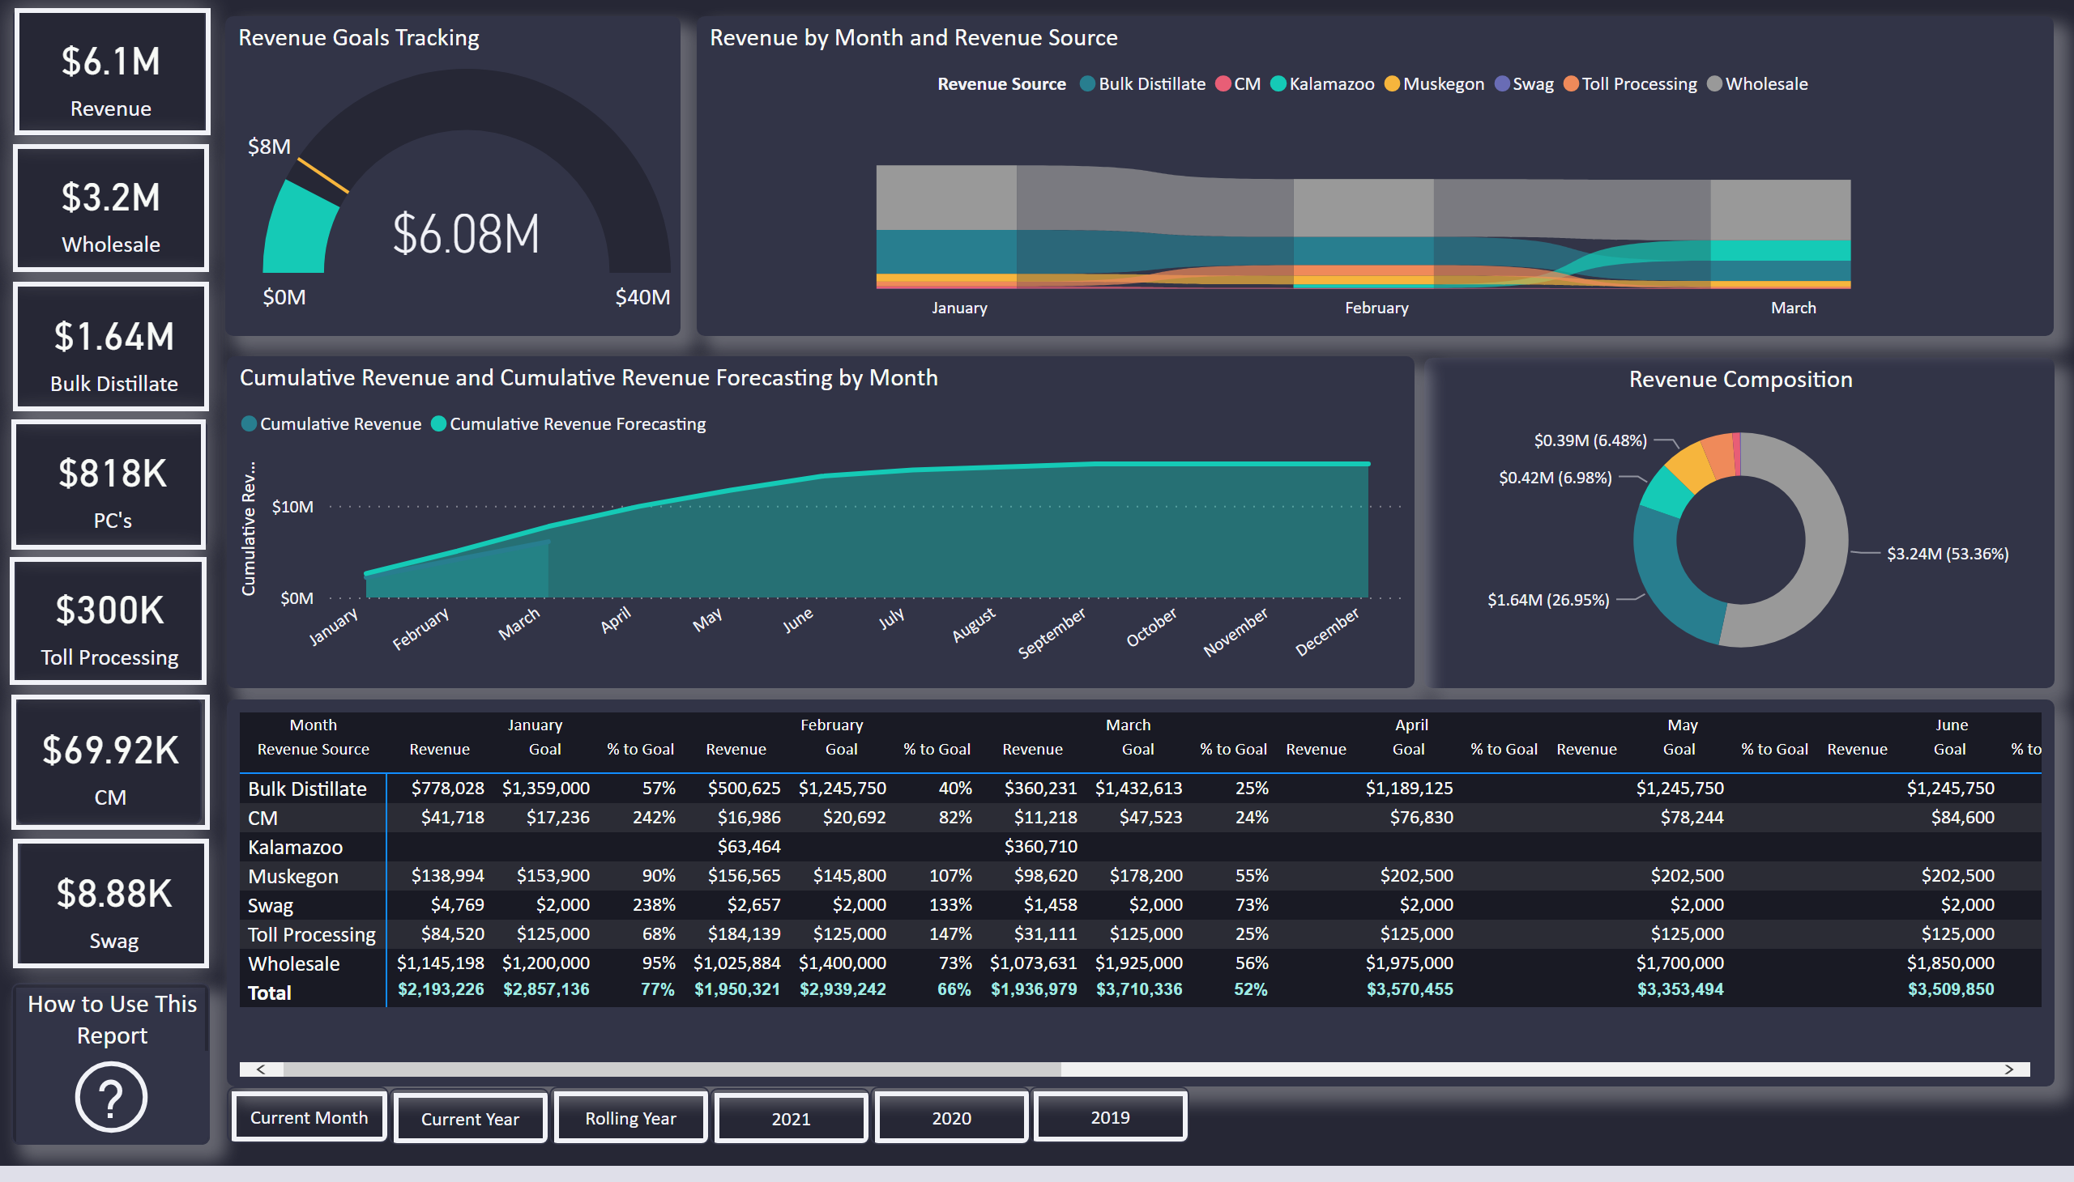
Revenue Overview
Notes:
Revenue Card
No alt text provided
Wholesale Card
No alt text provided
Distillate Card
No alt text provided
PC Card
No alt text provided
Toll Card
No alt text provided
Swag Card
No alt text provided
PC Button
No alt text provided
Wholesale Button
No alt text provided
Distillate Button
No alt text provided
Toll Button
No alt text provided
CM Button
No alt text provided
Swag Button
No alt text provided
Revenue Button
No alt text provided
Revenue Composition
No alt text provided
pivotTable
No alt text provided
ribbonChart
No alt text provided
Revenue Goals Tracking
No alt text provided
areaChart
No alt text provided
How to Use This Report
No alt text provided
textbox
No alt text provided
actionButton
No alt text provided
actionButton
No alt text provided
actionButton
No alt text provided
CM Card
No alt text provided
actionButton
No alt text provided
actionButton
No alt text provided
actionButton
No alt text provided
actionButton
No alt text provided

Slide 3
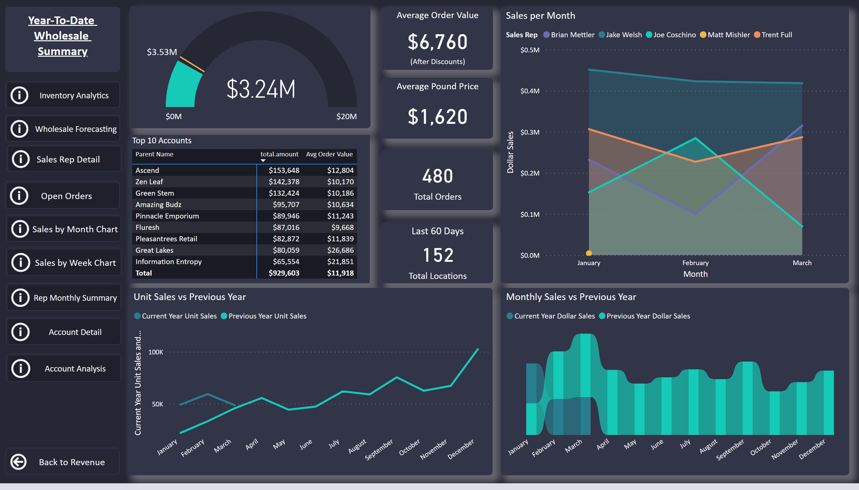
Wholesale Summary
Notes:
actionButton
No alt text provided
Average Order Value
No alt text provided
Average Pound Price
No alt text provided
Top 10 Accounts
No alt text provided
textbox
No alt text provided
actionButton
No alt text provided
gauge
No alt text provided
Monthly Sales vs Previous Year
No alt text provided
Unit Sales vs Previous Year
No alt text provided
Sales per Month
No alt text provided
card
No alt text provided
Last 60 Days
No alt text provided
actionButton
No alt text provided
actionButton
No alt text provided
actionButton
No alt text provided
actionButton
No alt text provided
actionButton
No alt text provided
actionButton
No alt text provided
actionButton
No alt text provided
actionButton
No alt text provided

Slide 4
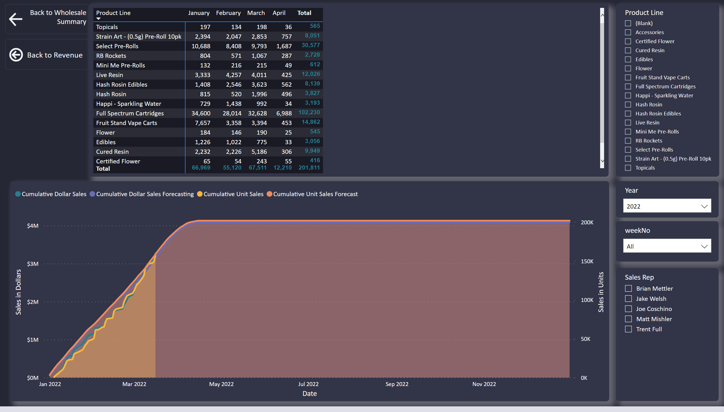
Wholesale Forecasting
Notes:
Cumulative Forecasting and Sales
No alt text provided
slicer
No alt text provided
slicer
No alt text provided
pivotTable
No alt text provided
slicer
No alt text provided
slicer
No alt text provided
actionButton
No alt text provided
actionButton
No alt text provided

Slide 5
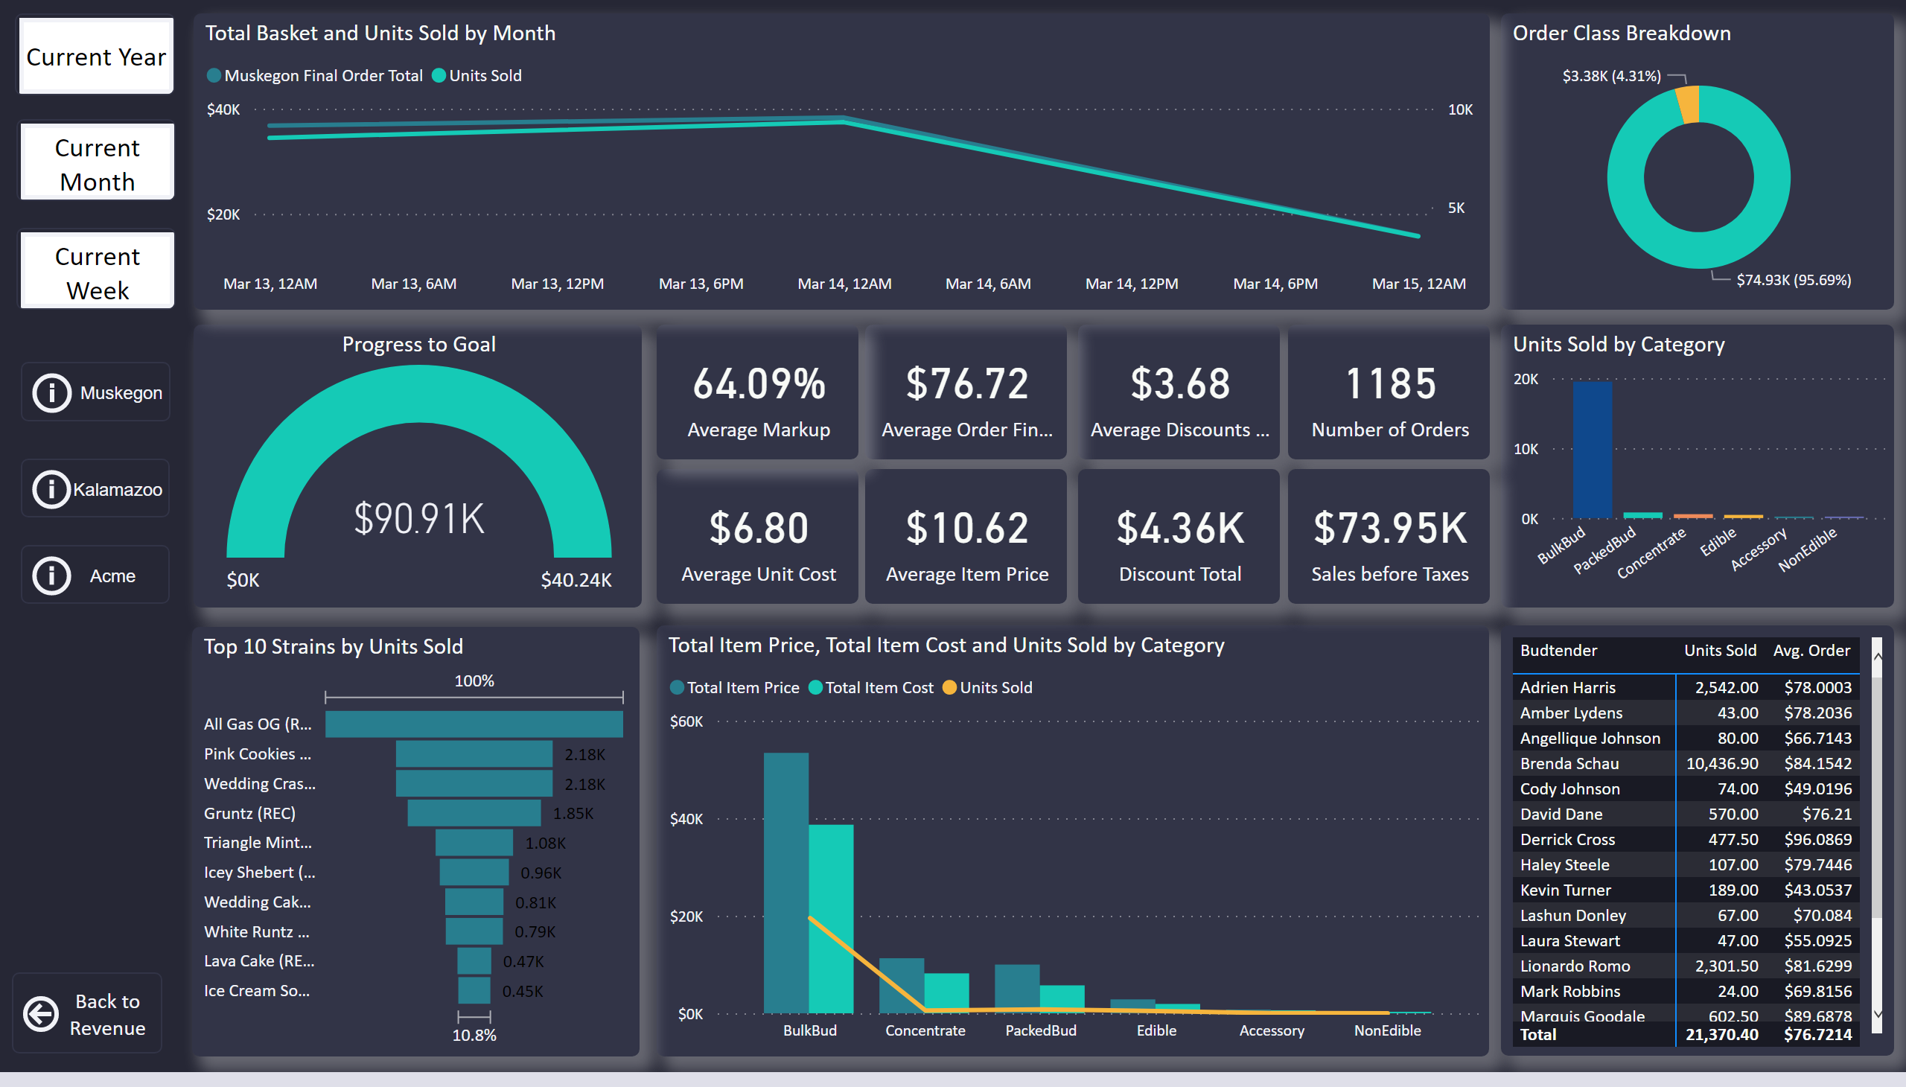
PC Summary
Notes:
Order Class Breakdown
No alt text provided
Units Sold by Category
No alt text provided
Total Item Price, Total Item Cost and Units Sold by Category
No alt text provided
card
No alt text provided
card
No alt text provided
Progress to Goal
No alt text provided
card
No alt text provided
card
No alt text provided
card
No alt text provided
Top 10 Strains by Units Sold
No alt text provided
card
No alt text provided
card
No alt text provided
card
No alt text provided
Total Basket and Units Sold by Month
No alt text provided
actionButton
No alt text provided
pivotTable
No alt text provided
actionButton
No alt text provided
actionButton
No alt text provided
actionButton
No alt text provided
actionButton
No alt text provided
actionButton
No alt text provided
actionButton
No alt text provided

Slide 6
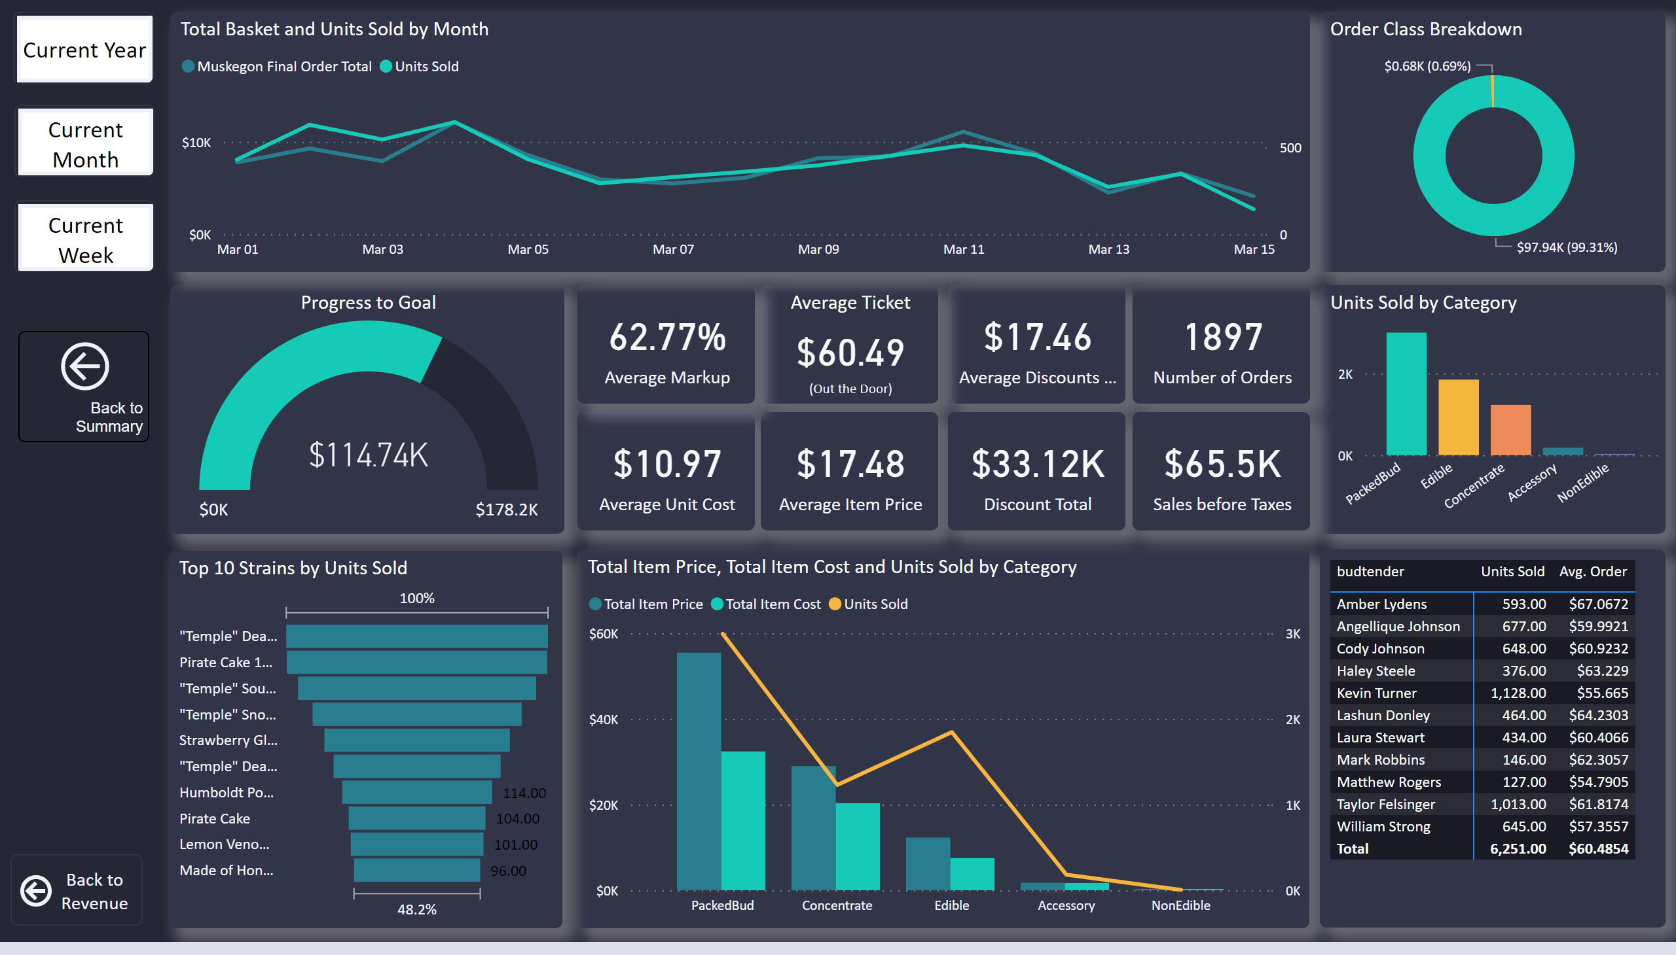
Muskegon Summary
Notes:
Order Class Breakdown
No alt text provided
Units Sold by Category
No alt text provided
Total Item Price, Total Item Cost and Units Sold by Category
No alt text provided
card
No alt text provided
Average Ticket
No alt text provided
Progress to Goal
No alt text provided
card
No alt text provided
card
No alt text provided
card
No alt text provided
Top 10 Strains by Units Sold
No alt text provided
card
No alt text provided
card
No alt text provided
card
No alt text provided
Total Basket and Units Sold by Month
No alt text provided
actionButton
No alt text provided
pivotTable
No alt text provided
actionButton
No alt text provided
actionButton
No alt text provided
actionButton
No alt text provided
actionButton
No alt text provided

Slide 7
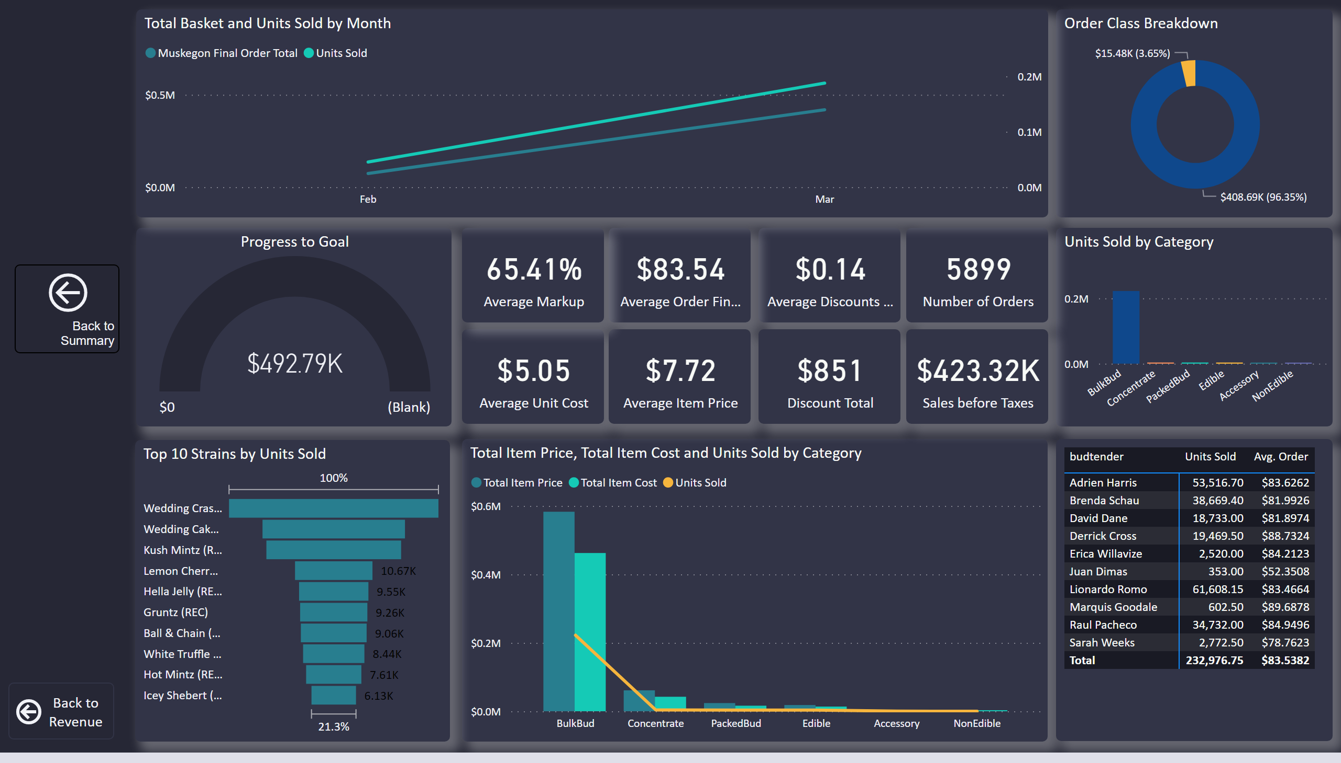
Kalamazoo Summary
Notes:
Order Class Breakdown
No alt text provided
Units Sold by Category
No alt text provided
Total Item Price, Total Item Cost and Units Sold by Category
No alt text provided
card
No alt text provided
card
No alt text provided
Progress to Goal
No alt text provided
card
No alt text provided
card
No alt text provided
card
No alt text provided
Top 10 Strains by Units Sold
No alt text provided
card
No alt text provided
card
No alt text provided
card
No alt text provided
Total Basket and Units Sold by Month
No alt text provided
pivotTable
No alt text provided
actionButton
No alt text provided
actionButton
No alt text provided

Slide 8
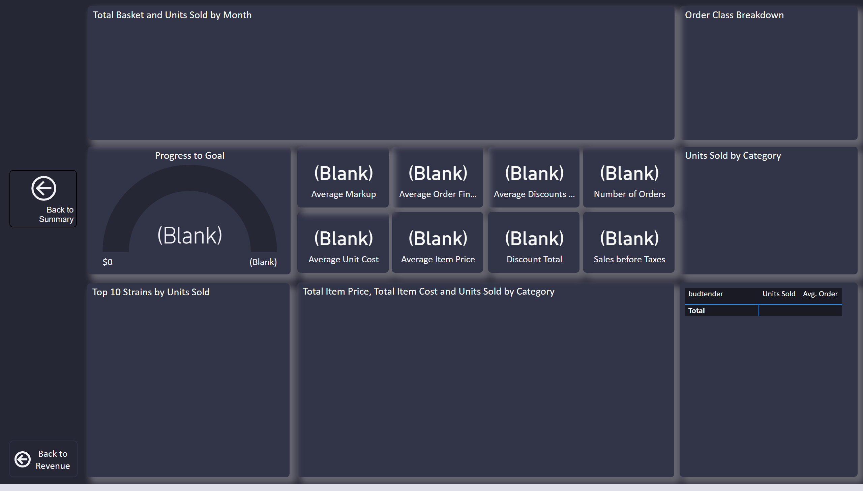
Acme Summary
Notes:
Order Class Breakdown
No alt text provided
Units Sold by Category
No alt text provided
Total Item Price, Total Item Cost and Units Sold by Category
No alt text provided
card
No alt text provided
card
No alt text provided
Progress to Goal
No alt text provided
card
No alt text provided
card
No alt text provided
card
No alt text provided
Top 10 Strains by Units Sold
No alt text provided
card
No alt text provided
card
No alt text provided
card
No alt text provided
Total Basket and Units Sold by Month
No alt text provided
pivotTable
No alt text provided
actionButton
No alt text provided
actionButton
No alt text provided

Slide 9
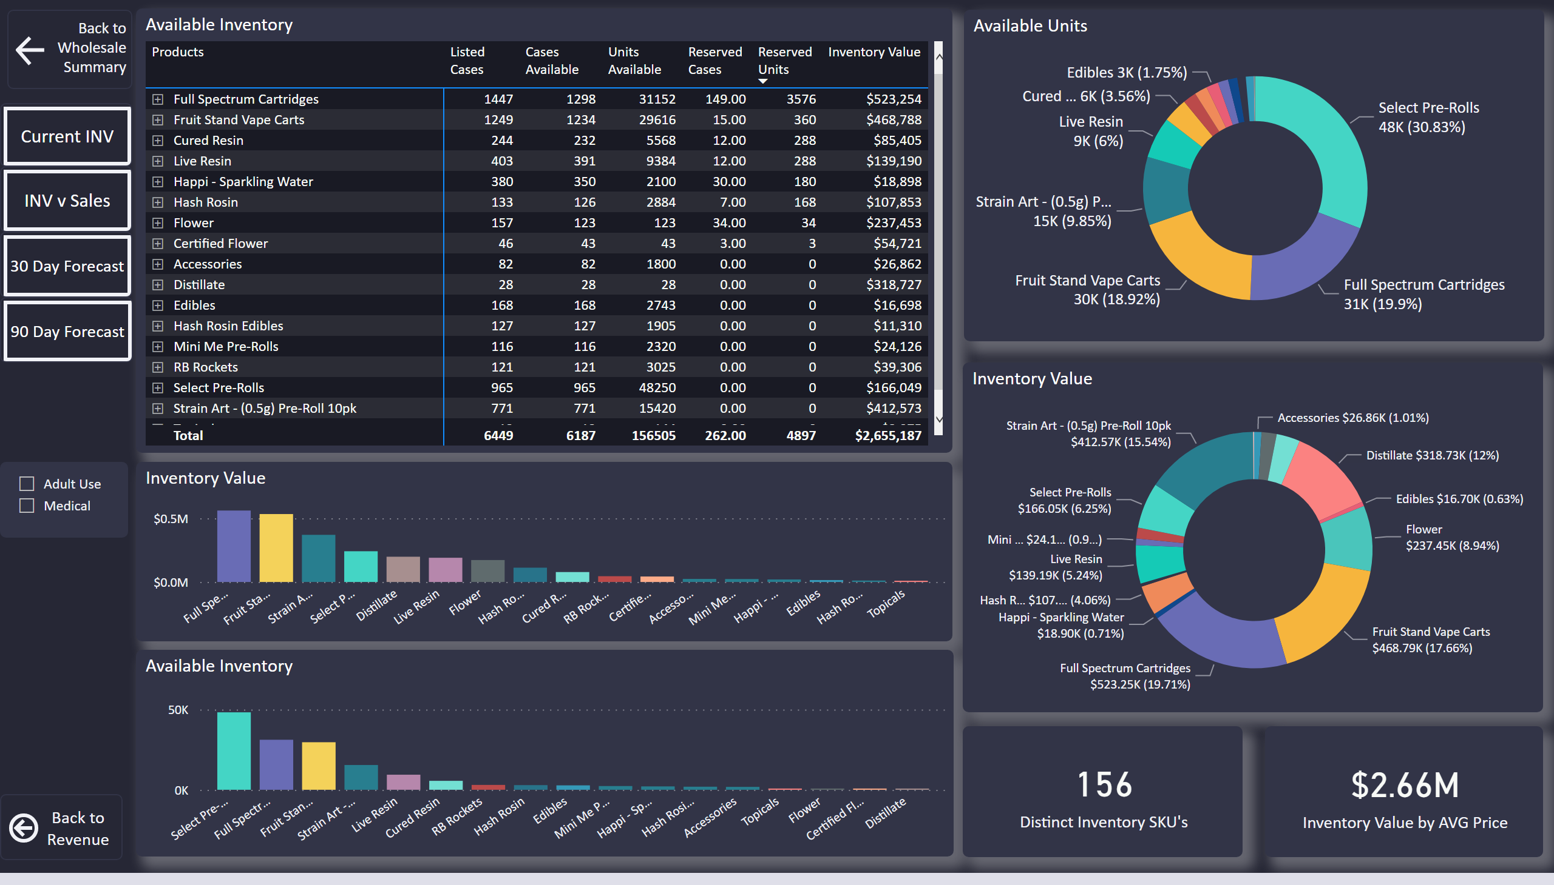
LL Inventory Analytics
Notes:
Available Inventory
No alt text provided
Available Units
No alt text provided
Inventory Value
No alt text provided
Available Inventory
No alt text provided
card
No alt text provided
card
No alt text provided
Inventory Value
No alt text provided
actionButton
No alt text provided
pivotTable
No alt text provided
lineChart
No alt text provided
stackedAreaChart
No alt text provided
donutChart
No alt text provided
donutChart
No alt text provided
actionButton
No alt text provided
actionButton
No alt text provided
pivotTable
No alt text provided
areaChart
No alt text provided
lineChart
No alt text provided
card
No alt text provided
card
No alt text provided
actionButton
No alt text provided
actionButton
No alt text provided
actionButton
No alt text provided
slicer
No alt text provided

Slide 10
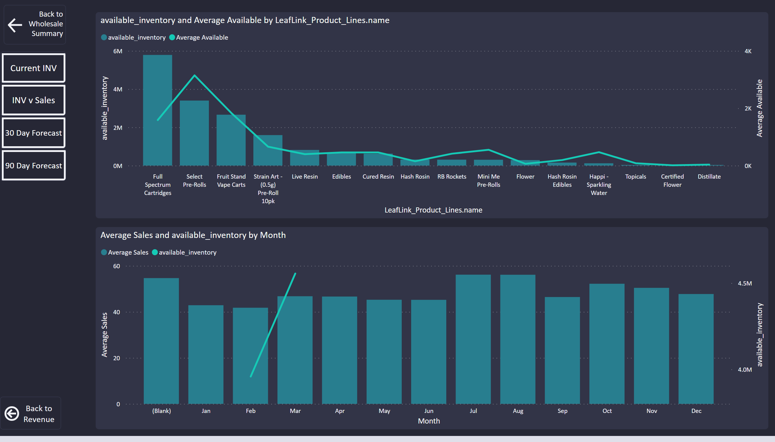
3 month inventory forecast
Notes:
actionButton
No alt text provided
actionButton
No alt text provided
actionButton
No alt text provided
actionButton
No alt text provided
actionButton
No alt text provided
actionButton
No alt text provided
lineStackedColumnComboChart
No alt text provided
lineStackedColumnComboChart
No alt text provided

Slide 11
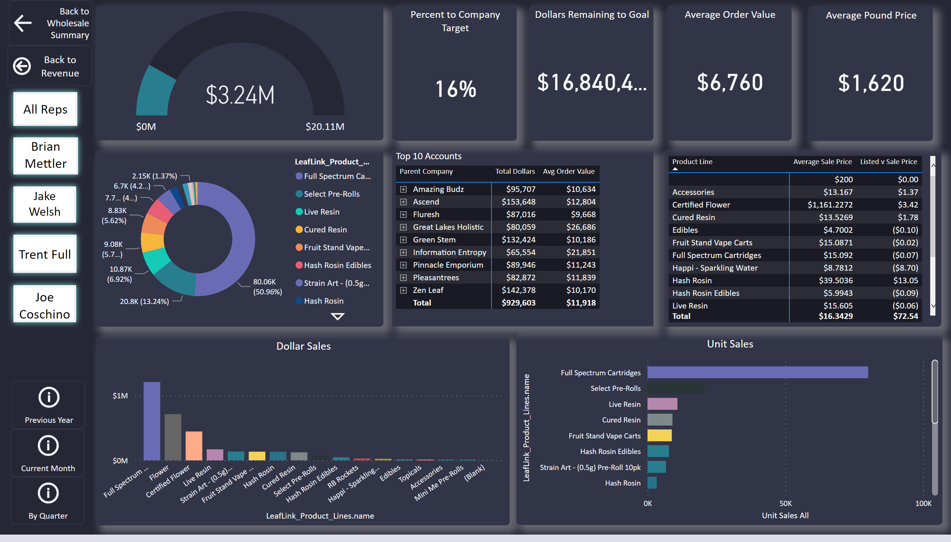
Sales Rep Breakdown
Notes:
Dollar Sales
No alt text provided
Unit Sales
No alt text provided
donutChart
No alt text provided
pivotTable
No alt text provided
Average Pound Price
No alt text provided
Average Order Value
No alt text provided
Top 10 Accounts
No alt text provided
actionButton
No alt text provided
actionButton
No alt text provided
actionButton
No alt text provided
actionButton
No alt text provided
actionButton
No alt text provided
actionButton
No alt text provided
actionButton
No alt text provided
actionButton
No alt text provided
actionButton
No alt text provided
gauge
No alt text provided
Percent to Company Target
No alt text provided
Dollars Remaining to Goal
No alt text provided
actionButton
No alt text provided

Slide 12
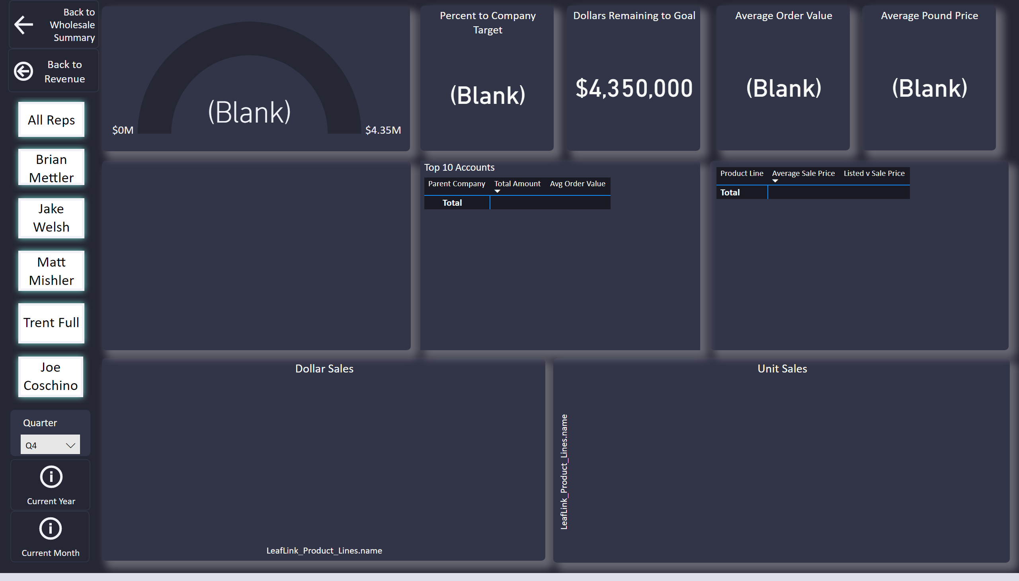
Reps by Quarter
Notes:
Dollar Sales
No alt text provided
Unit Sales
No alt text provided
donutChart
No alt text provided
pivotTable
No alt text provided
Average Pound Price
No alt text provided
Average Order Value
No alt text provided
Top 10 Accounts
No alt text provided
actionButton
No alt text provided
actionButton
No alt text provided
actionButton
No alt text provided
actionButton
No alt text provided
actionButton
No alt text provided
actionButton
No alt text provided
actionButton
No alt text provided
actionButton
No alt text provided
slicer
No alt text provided
actionButton
No alt text provided
actionButton
No alt text provided
gauge
No alt text provided
Percent to Company Target
No alt text provided
Dollars Remaining to Goal
No alt text provided

Slide 13
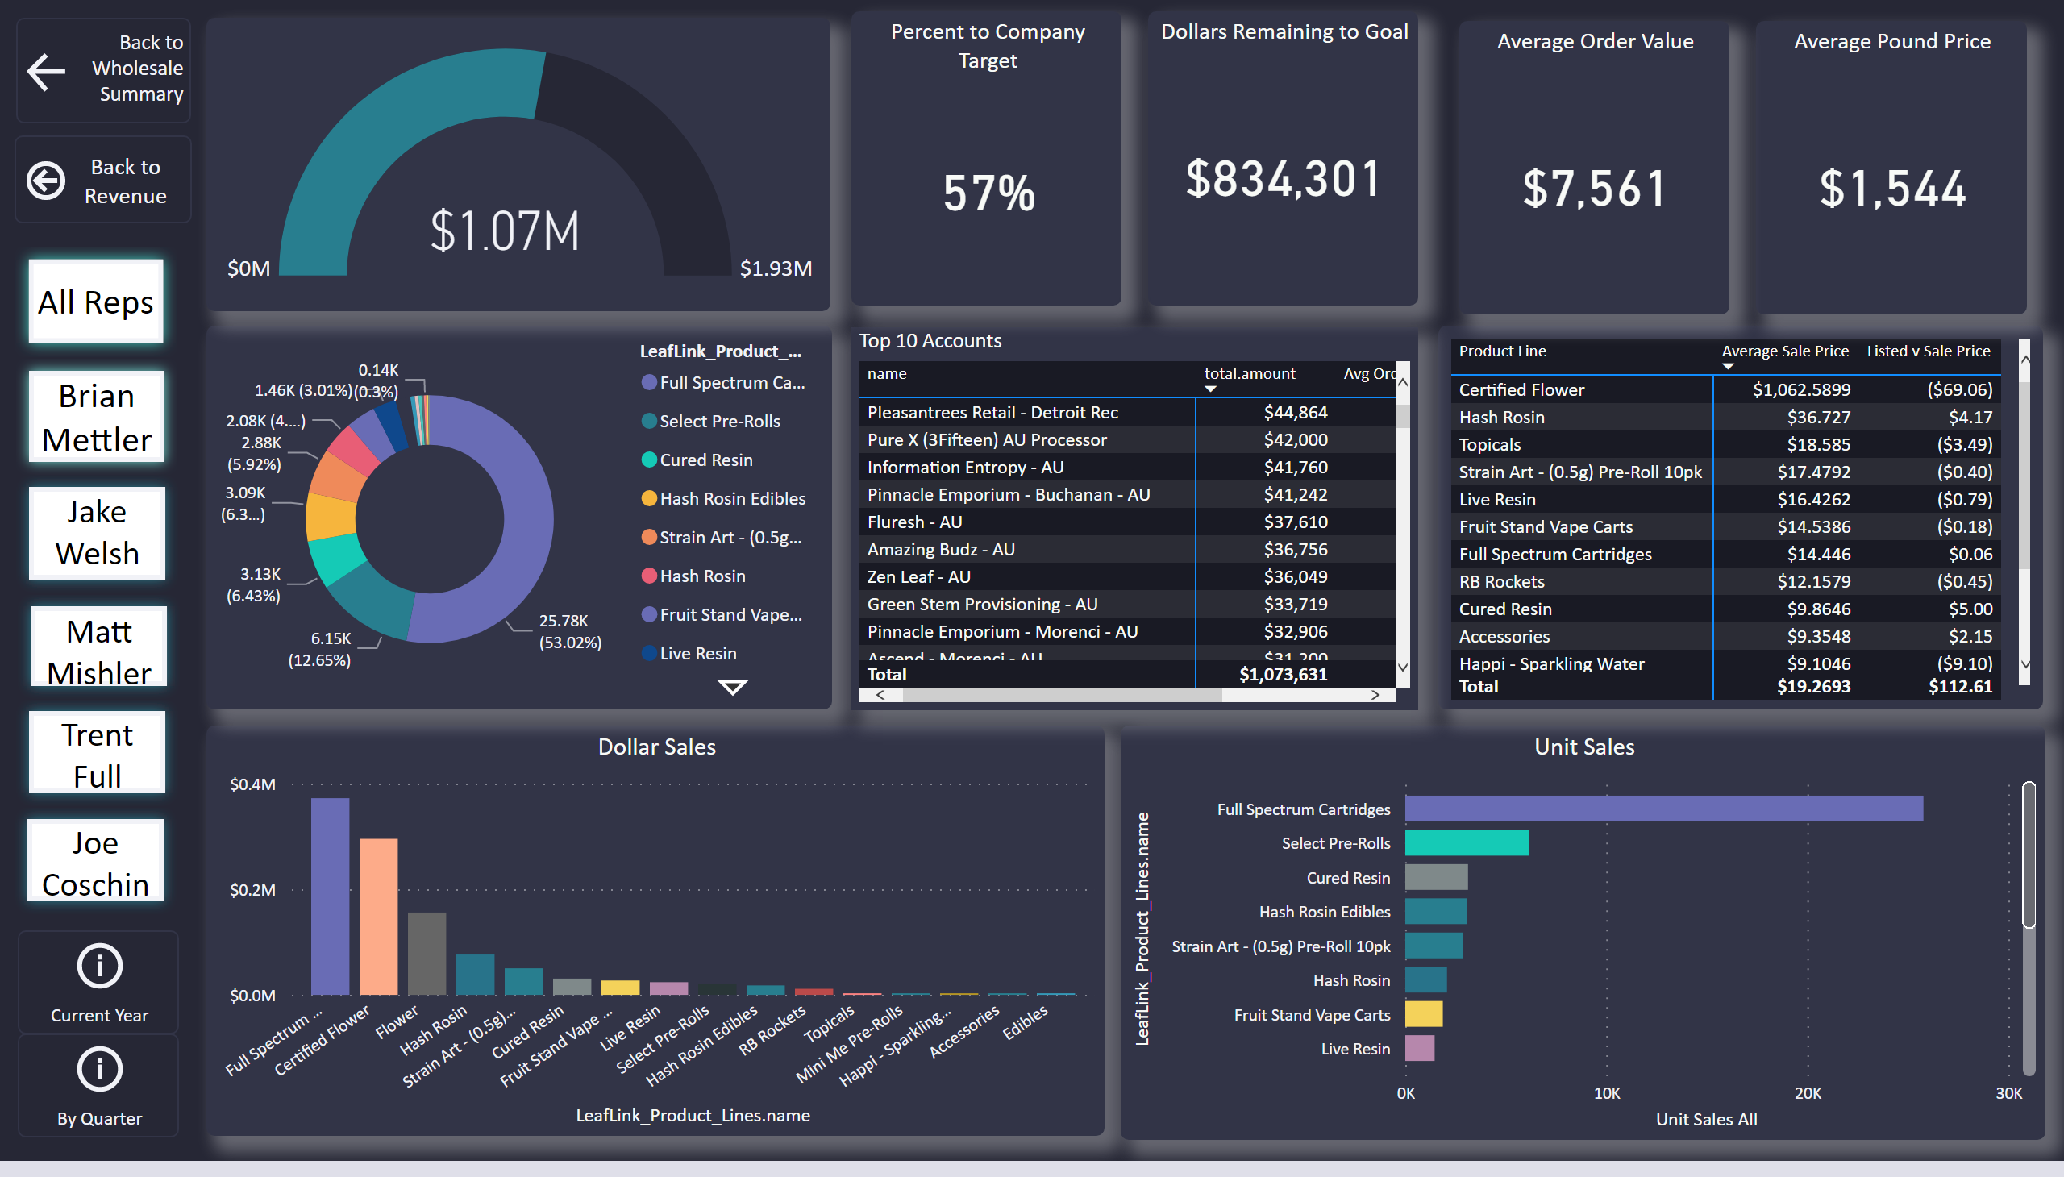
Reps by Month
Notes:
Dollar Sales
No alt text provided
Unit Sales
No alt text provided
donutChart
No alt text provided
pivotTable
No alt text provided
Average Pound Price
No alt text provided
Average Order Value
No alt text provided
Top 10 Accounts
No alt text provided
actionButton
No alt text provided
actionButton
No alt text provided
actionButton
No alt text provided
actionButton
No alt text provided
actionButton
No alt text provided
actionButton
No alt text provided
gauge
No alt text provided
actionButton
No alt text provided
actionButton
No alt text provided
actionButton
No alt text provided
actionButton
No alt text provided
gauge
No alt text provided
Percent to Company Target
No alt text provided
Dollars Remaining to Goal
No alt text provided

Slide 14
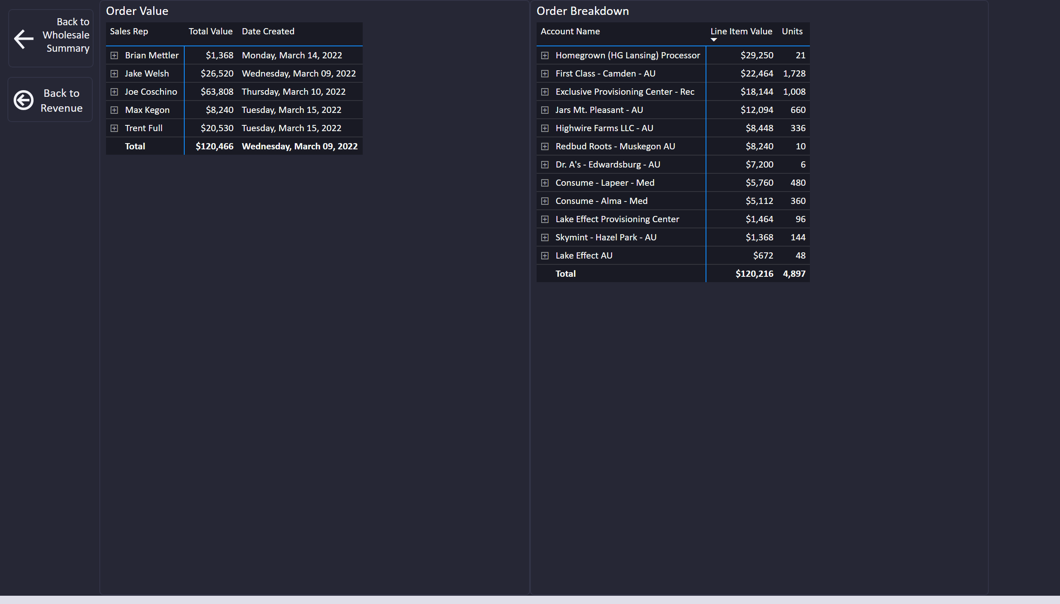
Open Orders
Notes:
Order Value
No alt text provided
Order Breakdown
No alt text provided
actionButton
No alt text provided
actionButton
No alt text provided

Slide 15
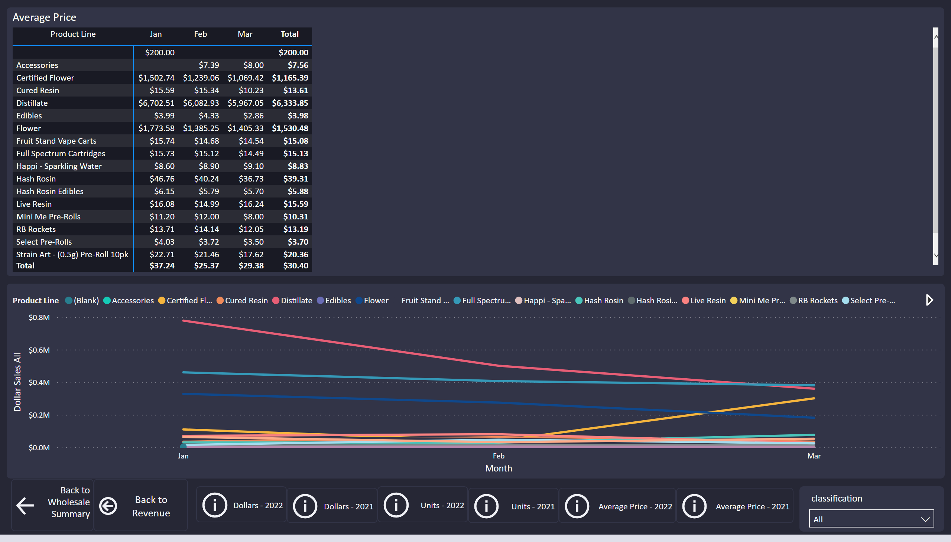
Sales by Month
Notes:
pivotTable
No alt text provided
pivotTable
No alt text provided
Wholesale Button
No alt text provided
lineChart
No alt text provided
areaChart
No alt text provided
Revenue Button
No alt text provided
2021 Dollars Button
No alt text provided
Current Year Dollars Button
No alt text provided
2021 Button
No alt text provided
Current Year Dollars Button
No alt text provided
Average Price
No alt text provided
Dollars Sold by Month
No alt text provided
2021 Button
No alt text provided
2021 Button
No alt text provided
slicer
No alt text provided

Slide 16
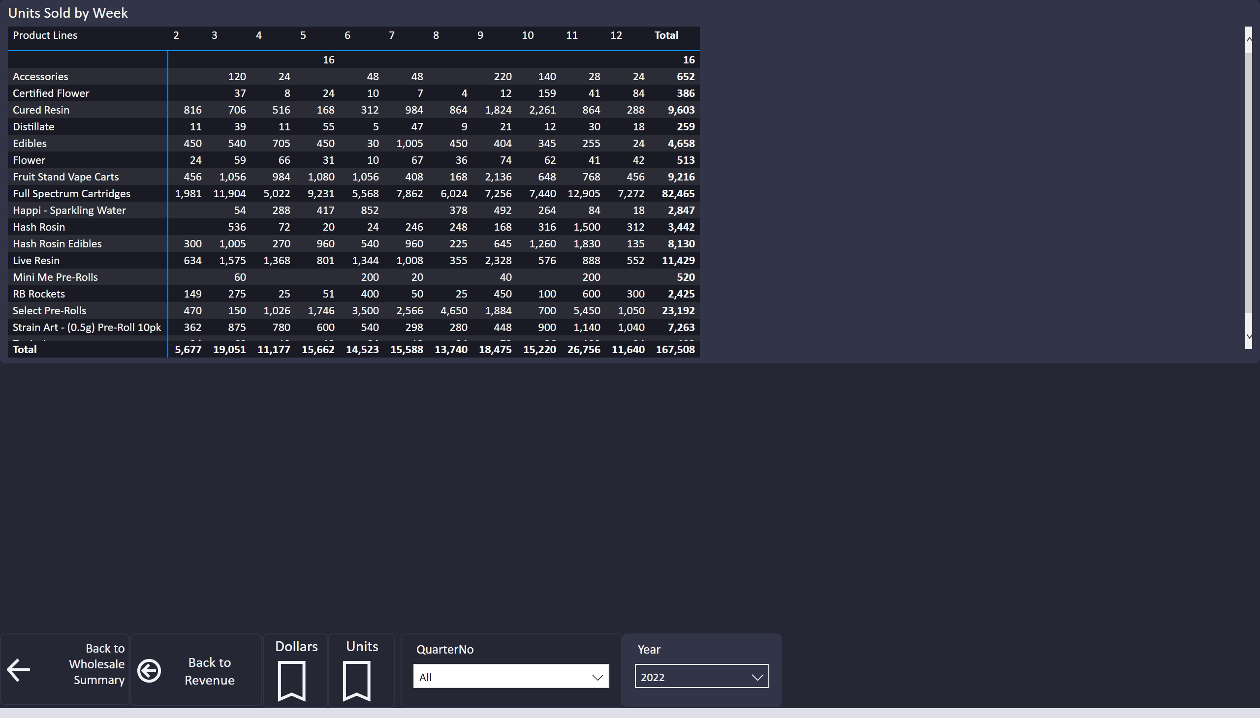
Sales by Week
Notes:
pivotTable
No alt text provided
Units Sold by Week
No alt text provided
pivotTable
No alt text provided
Dollars
No alt text provided
Units
No alt text provided
slicer
No alt text provided
actionButton
No alt text provided
actionButton
No alt text provided
slicer
No alt text provided

Slide 17
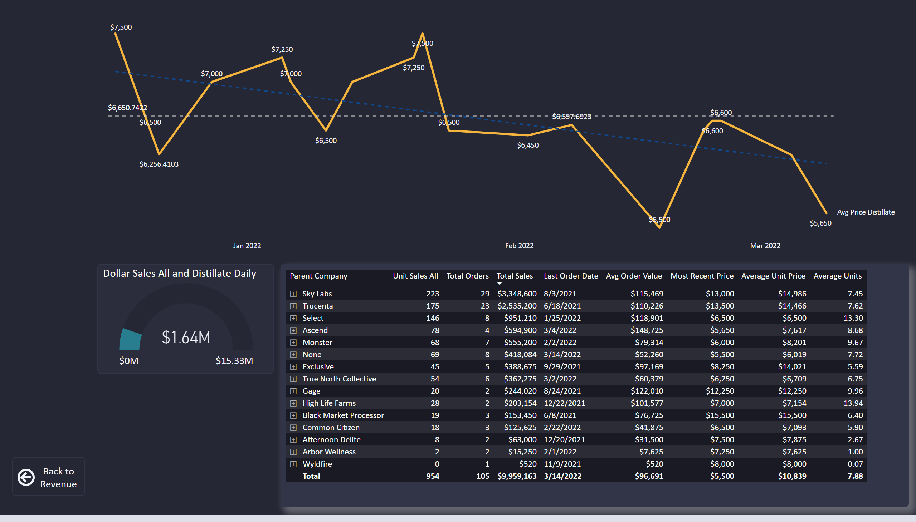
Bulk Distillate Overview
Notes:
actionButton
No alt text provided
pivotTable
No alt text provided
gauge
No alt text provided
lineChart
No alt text provided

Slide 18
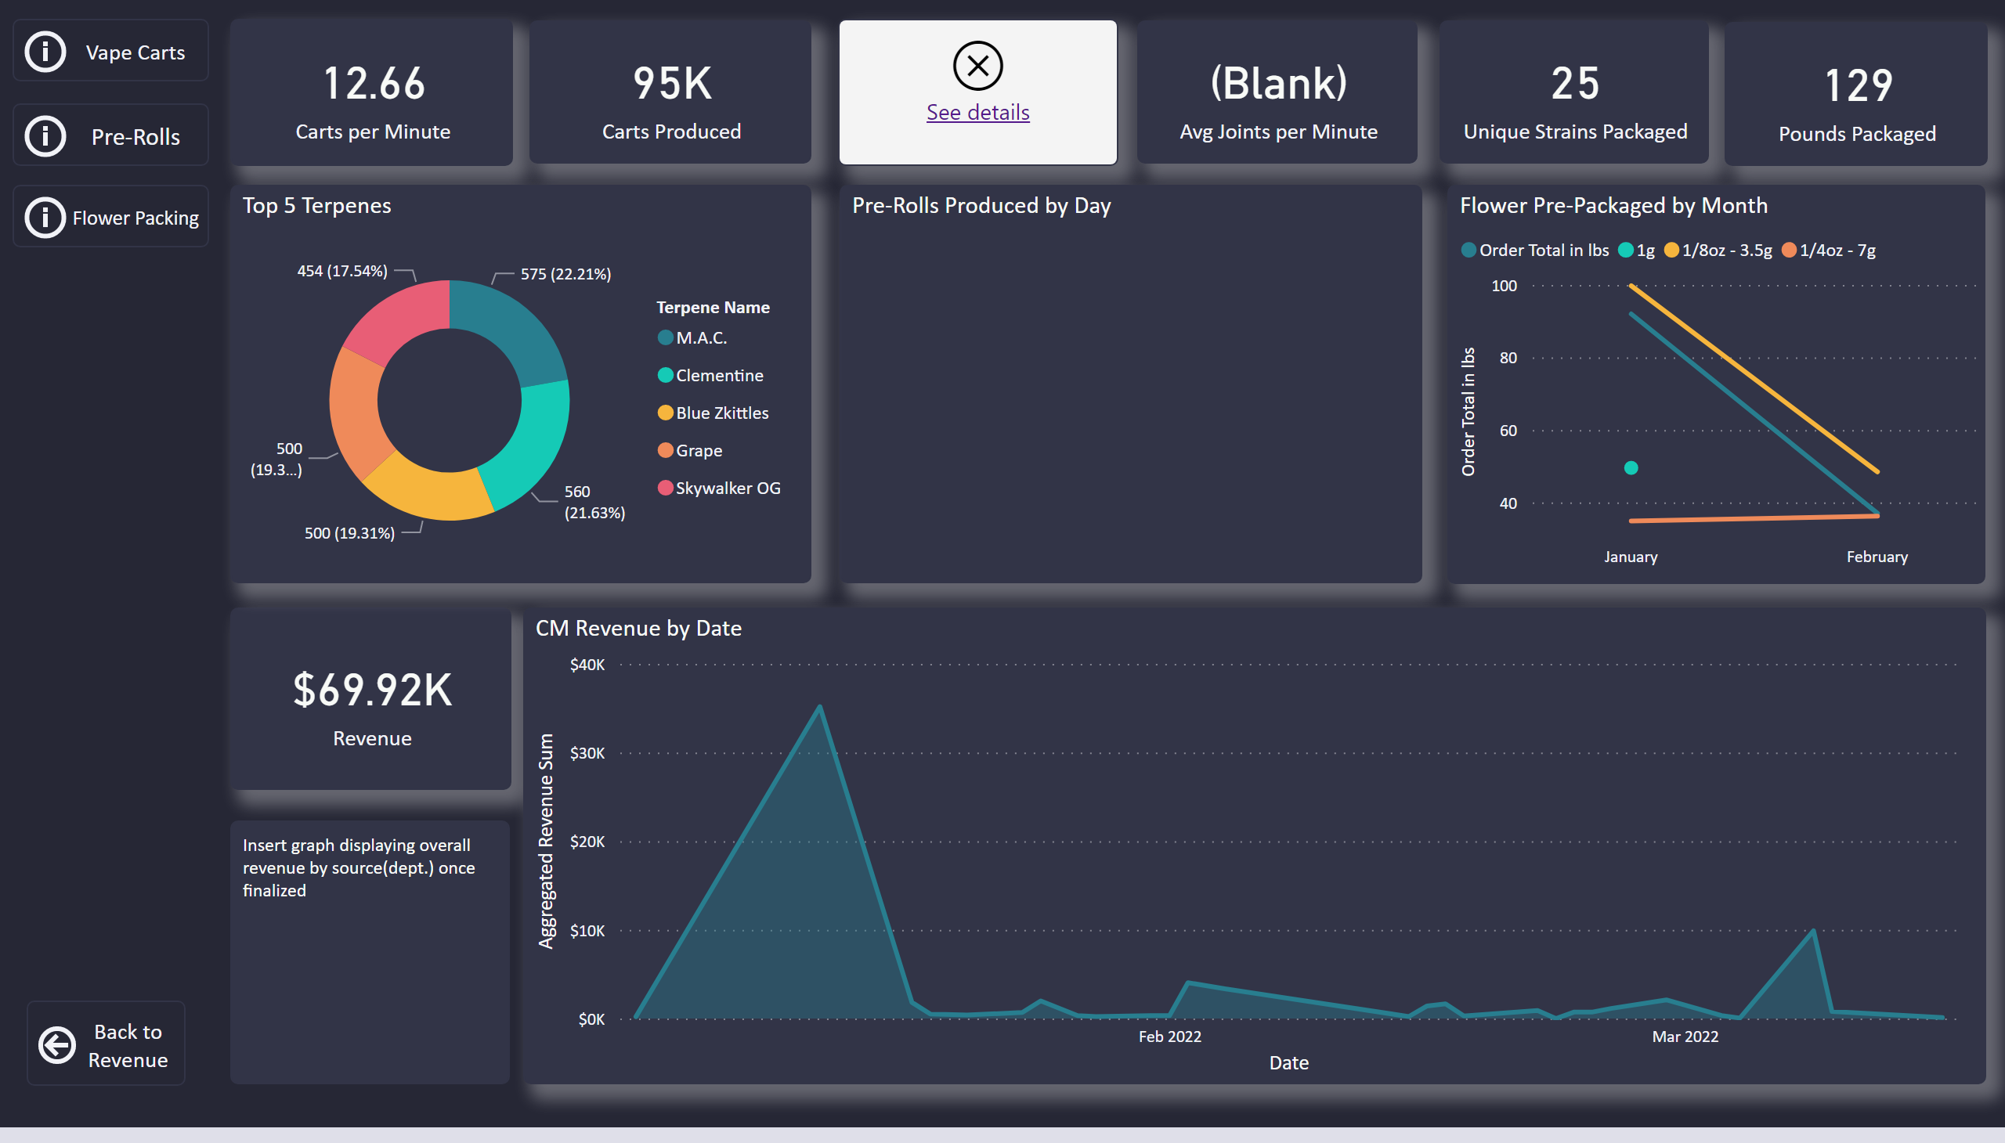
CM Overview
Notes:
actionButton
No alt text provided
card
No alt text provided
card
No alt text provided
card
No alt text provided
card
No alt text provided
card
No alt text provided
card
No alt text provided
card
No alt text provided
Flower Pre-Packaged by Month
No alt text provided
Pre-Rolls Produced by Day
No alt text provided
Top 5 Terpenes
No alt text provided
CM Revenue by Date
No alt text provided
textbox
No alt text provided
actionButton
No alt text provided
actionButton
No alt text provided
actionButton
No alt text provided

Slide 19
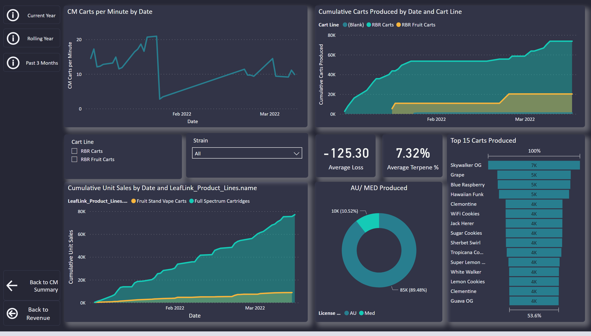
CM Vape Cart
Notes:
actionButton
No alt text provided
actionButton
No alt text provided
areaChart
No alt text provided
Top 15 Carts Produced
No alt text provided
lineChart
No alt text provided
card
No alt text provided
card
No alt text provided
AU/ MED Produced
No alt text provided
areaChart
No alt text provided
slicer
No alt text provided
slicer
No alt text provided
actionButton
No alt text provided
actionButton
No alt text provided
actionButton
No alt text provided

Slide 20
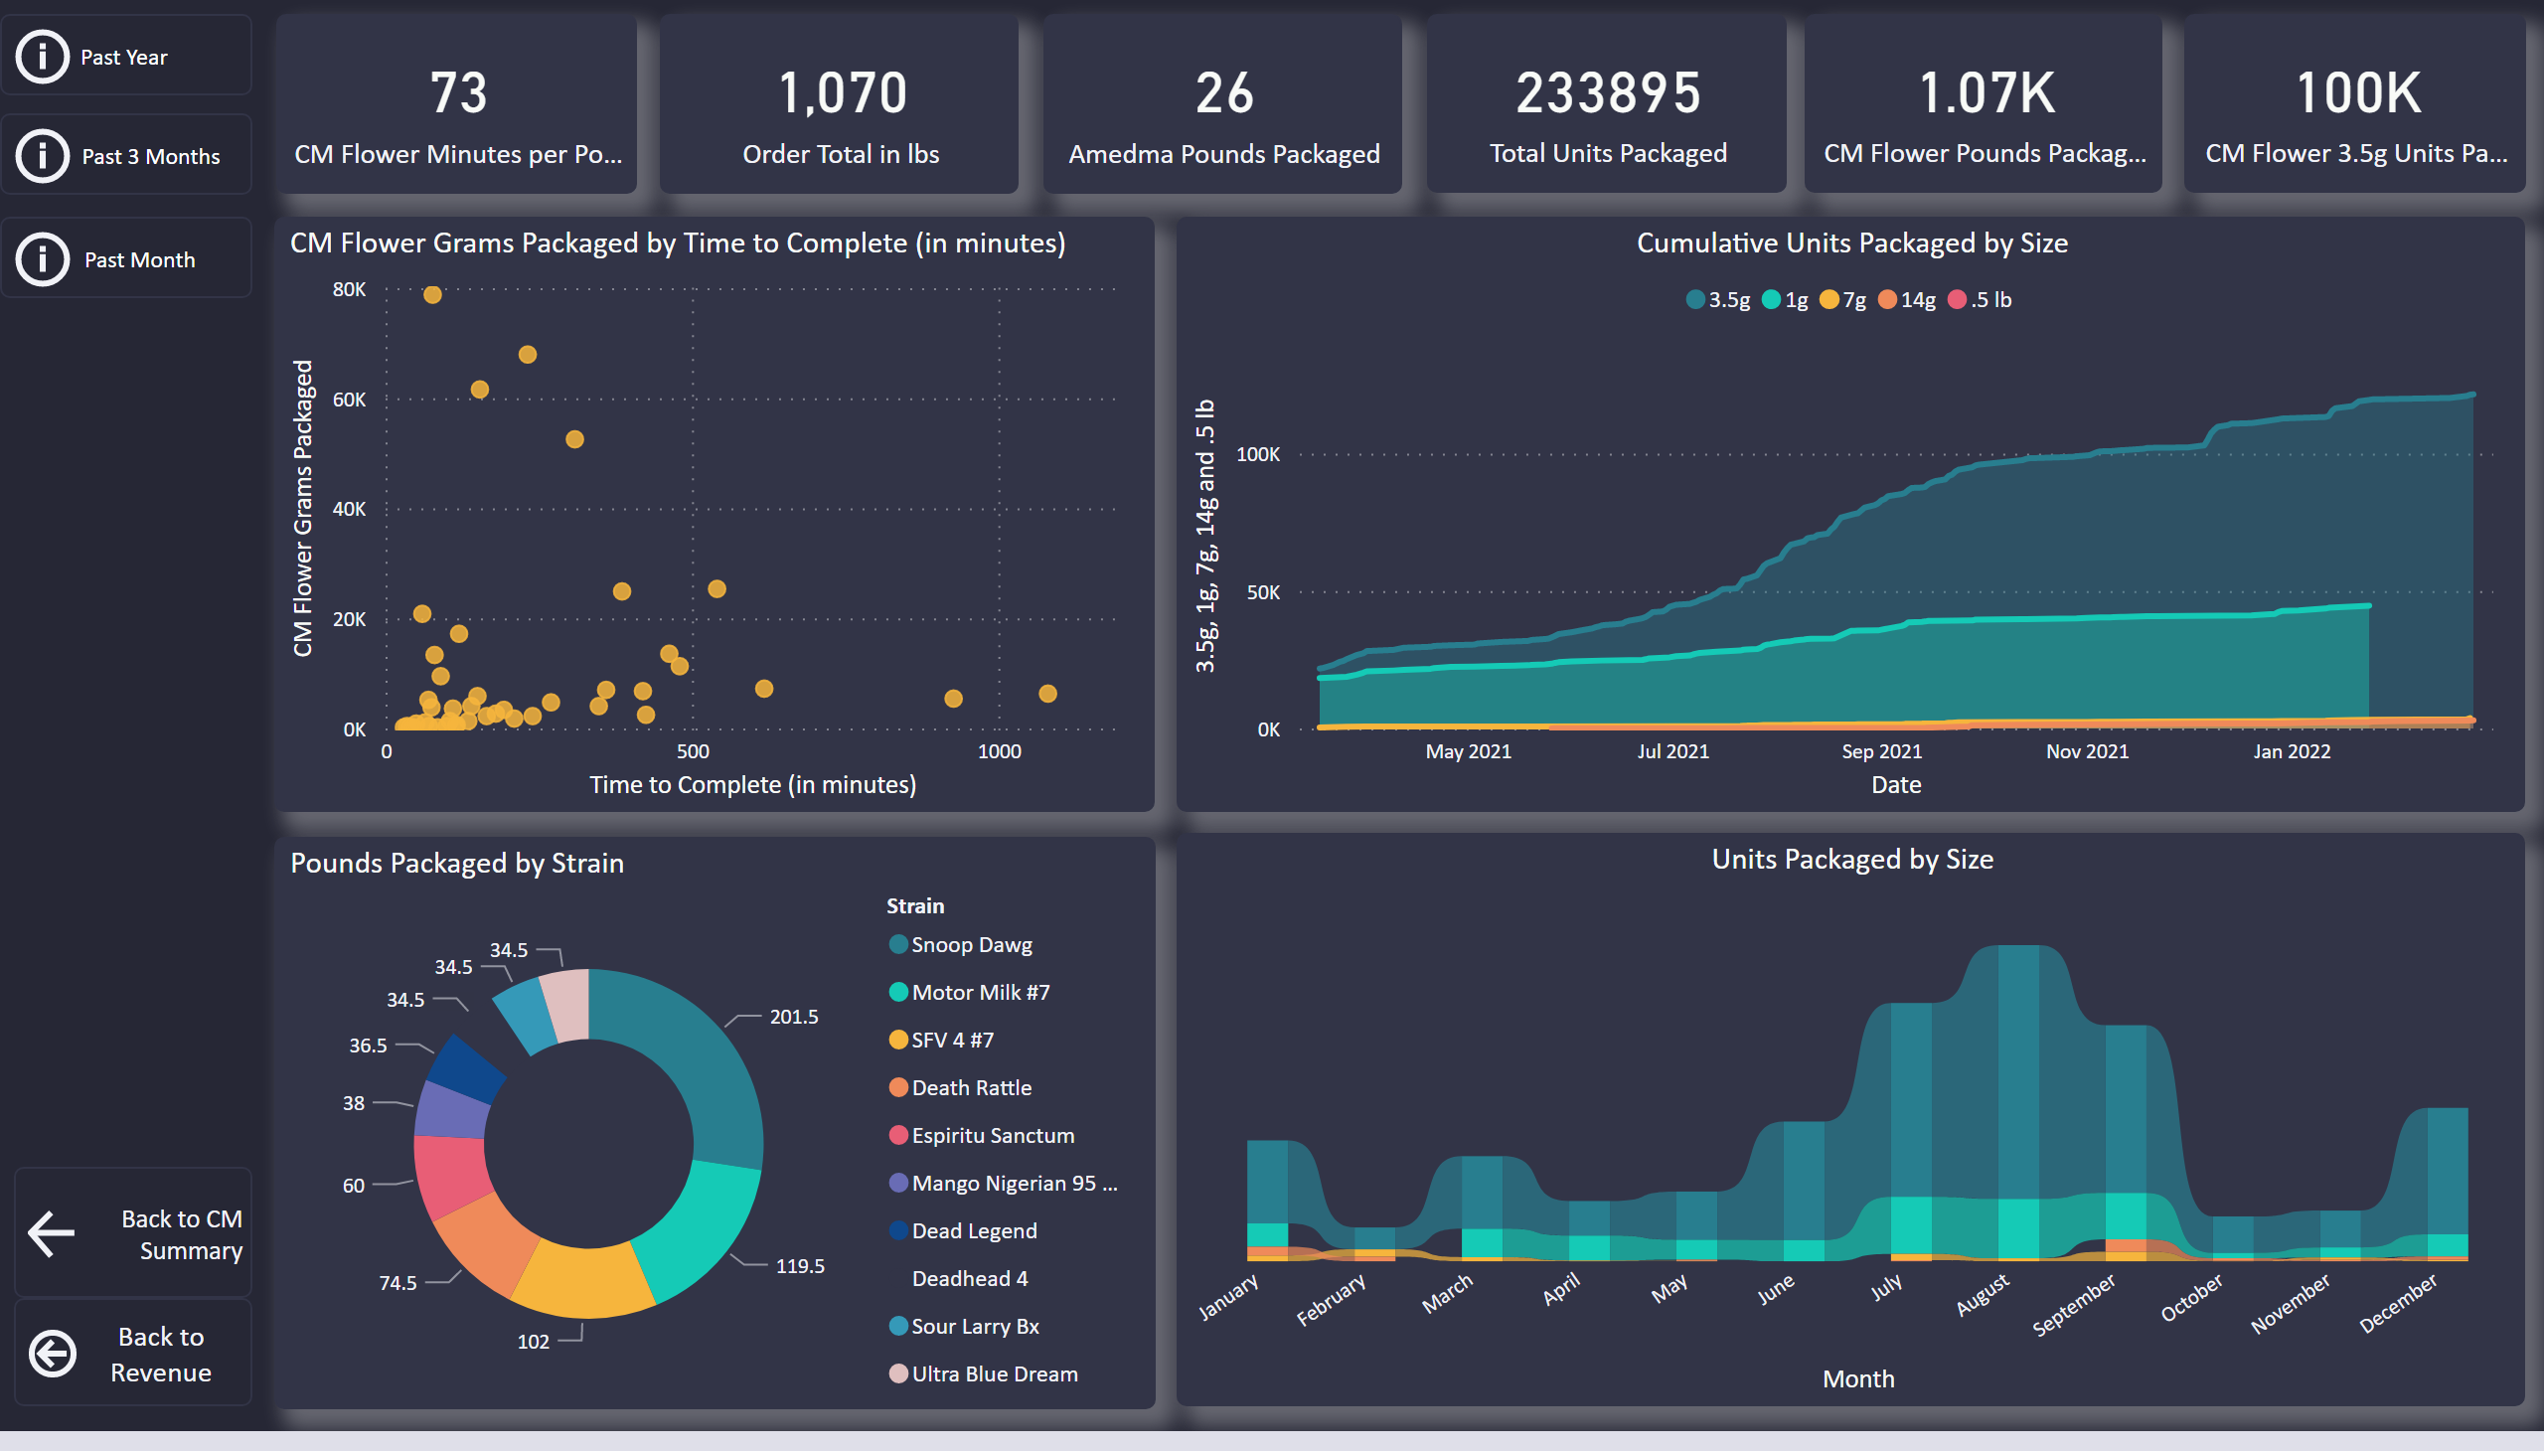
CM Flower Pack
Notes:
actionButton
No alt text provided
actionButton
No alt text provided
Cumulative Units Packaged by Size
No alt text provided
Units Packaged by Size
No alt text provided
Pounds Packaged by Strain
No alt text provided
scatterChart
No alt text provided
card
No alt text provided
card
No alt text provided
card
No alt text provided
card
No alt text provided
card
No alt text provided
card
No alt text provided
actionButton
No alt text provided
actionButton
No alt text provided
actionButton
No alt text provided

Slide 21
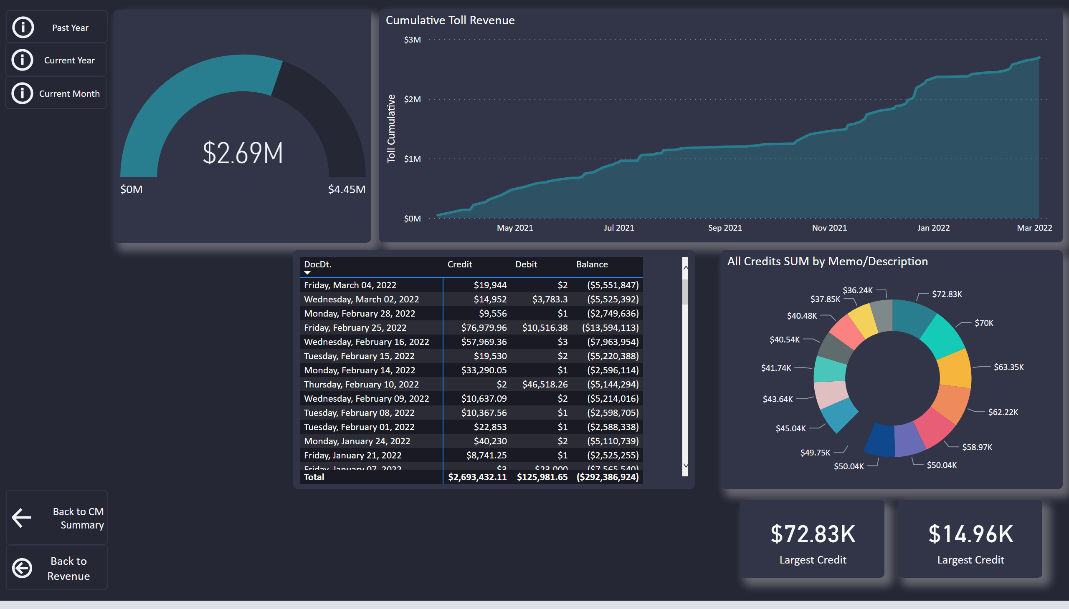
Toll Processing Overview
Notes:
Cumulative Toll Revenue
No alt text provided
actionButton
No alt text provided
actionButton
No alt text provided
gauge
No alt text provided
donutChart
No alt text provided
card
No alt text provided
card
No alt text provided
actionButton
No alt text provided
actionButton
No alt text provided
actionButton
No alt text provided
pivotTable
No alt text provided

Slide 22
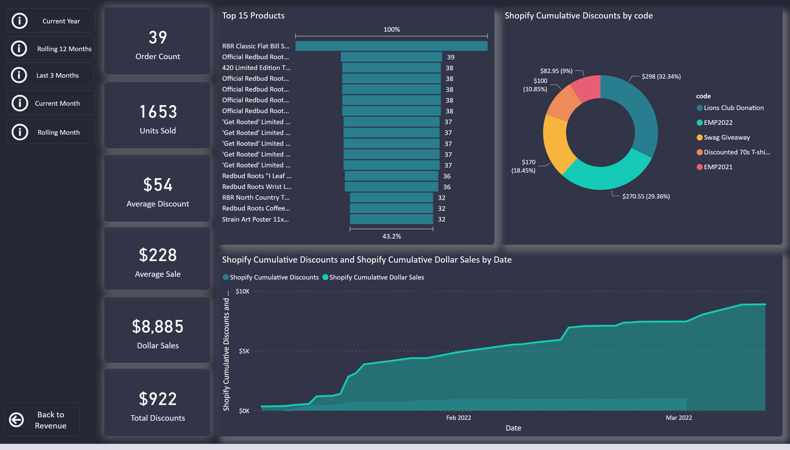
Swag
Notes:
actionButton
No alt text provided
areaChart
No alt text provided
actionButton
No alt text provided
card
No alt text provided
card
No alt text provided
donutChart
No alt text provided
card
No alt text provided
card
No alt text provided
card
No alt text provided
Top 15 Products
No alt text provided
card
No alt text provided
actionButton
No alt text provided
actionButton
No alt text provided
actionButton
No alt text provided
actionButton
No alt text provided

Slide 23
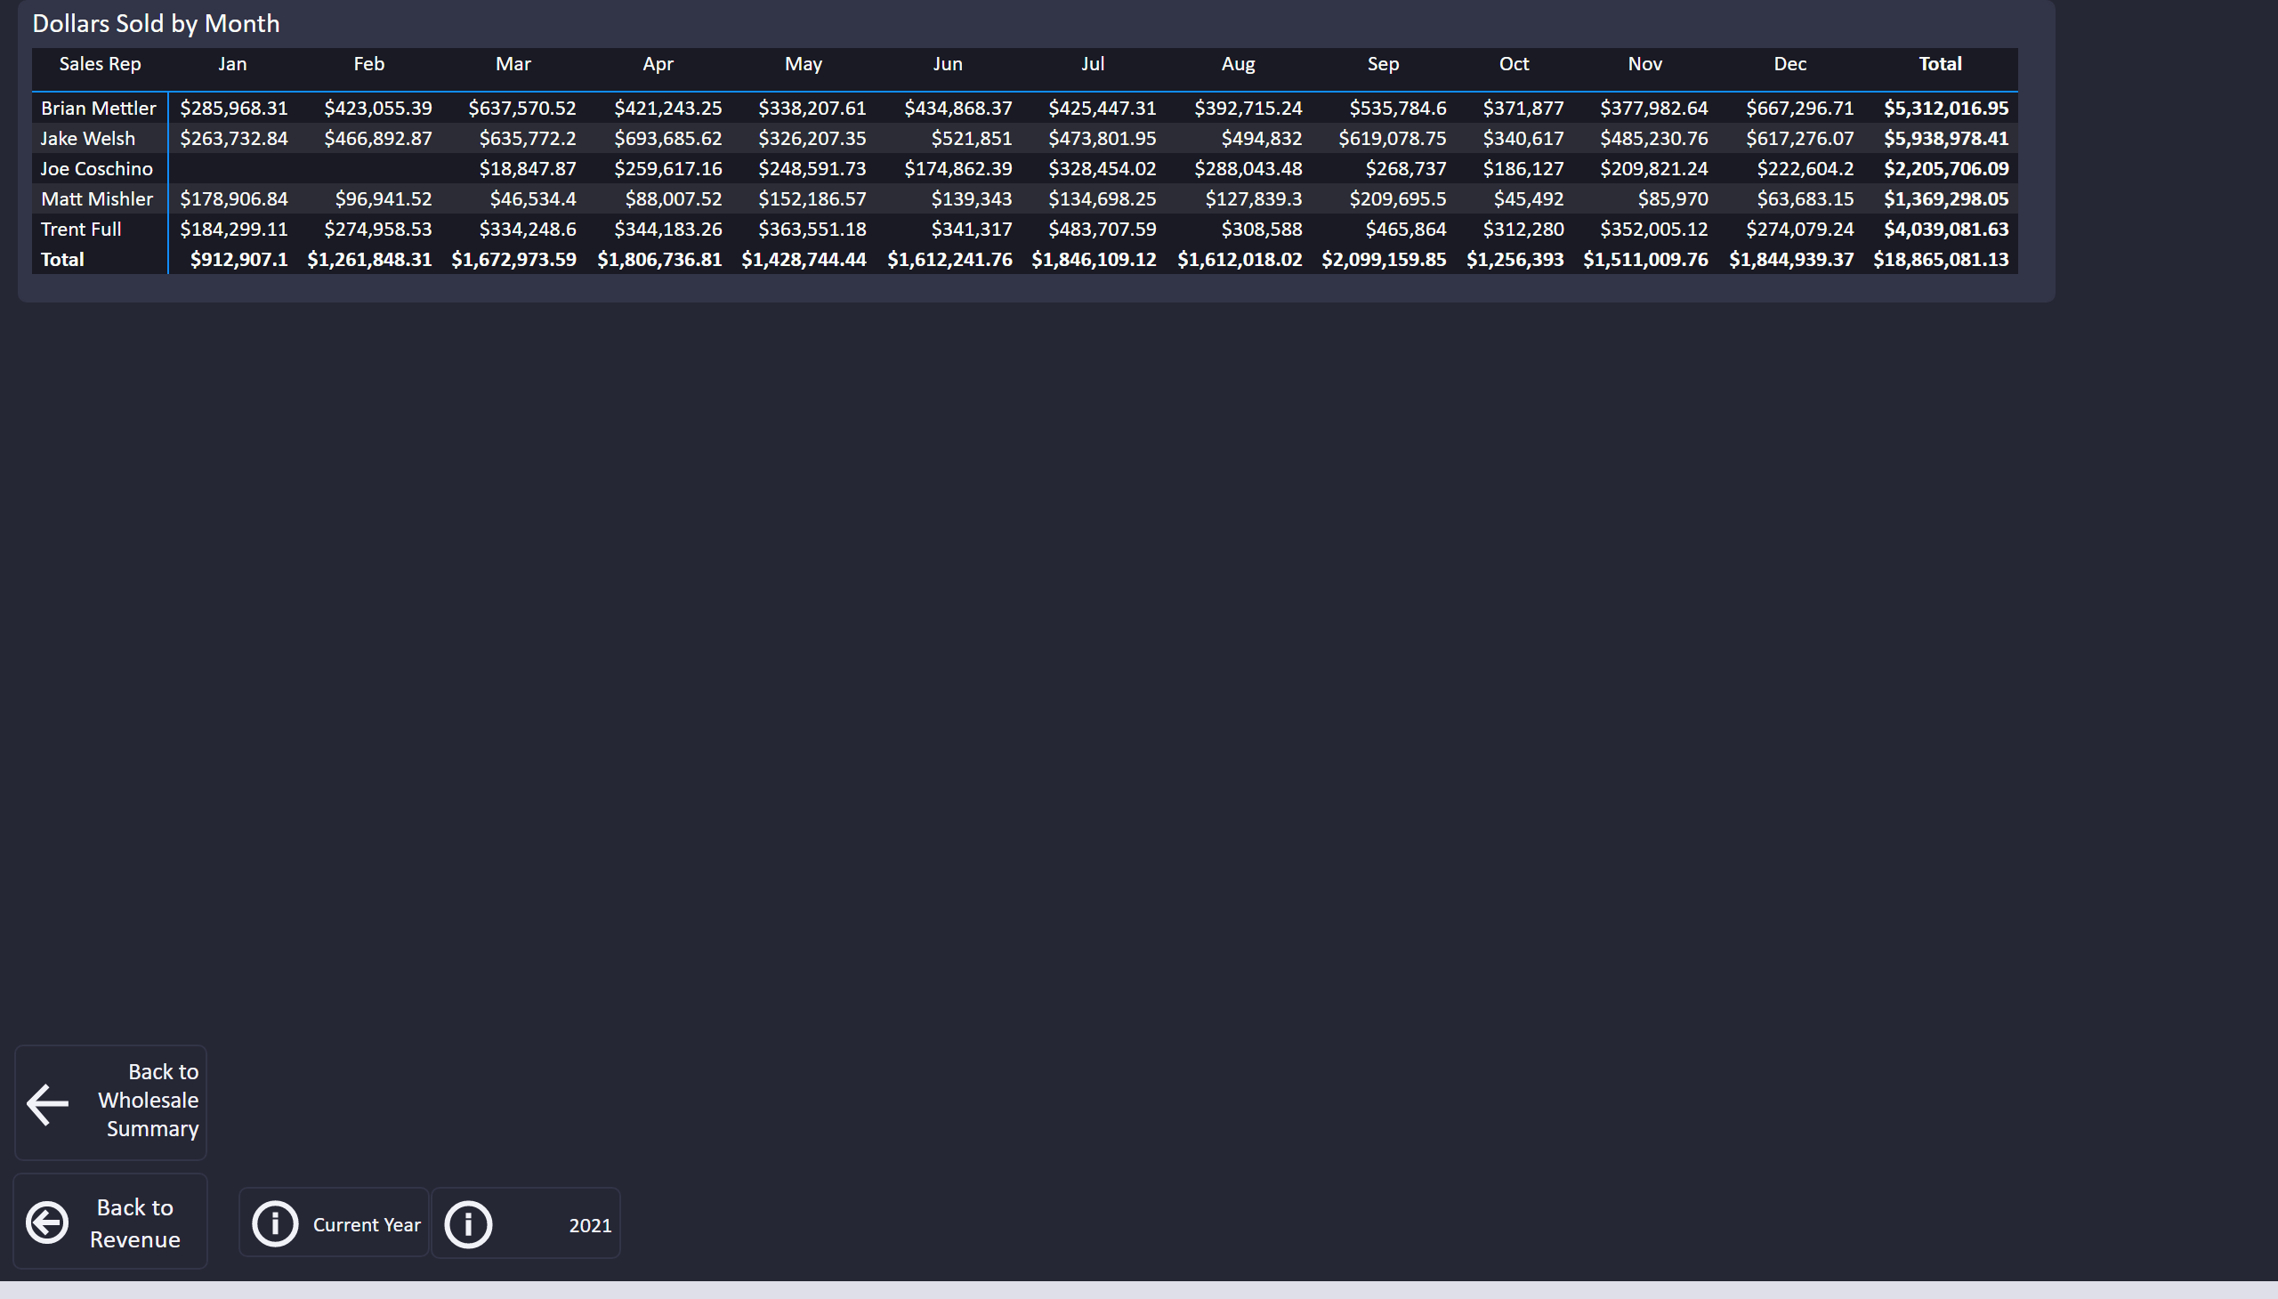
Sales by Rep per Month
Notes:
actionButton
No alt text provided
actionButton
No alt text provided
Dollars Sold by Month
No alt text provided
actionButton
No alt text provided
actionButton
No alt text provided

Slide 24
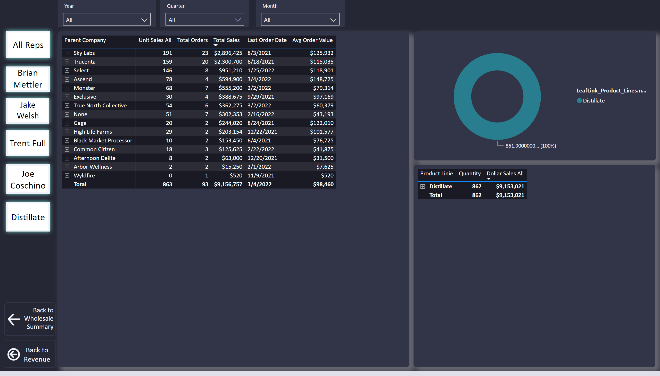
Account Detail
Notes:
pivotTable
No alt text provided
actionButton
No alt text provided
actionButton
No alt text provided
actionButton
No alt text provided
actionButton
No alt text provided
actionButton
No alt text provided
actionButton
No alt text provided
donutChart
No alt text provided
pivotTable
No alt text provided
actionButton
No alt text provided
actionButton
No alt text provided
slicer
No alt text provided
slicer
No alt text provided
slicer
No alt text provided

Slide 25
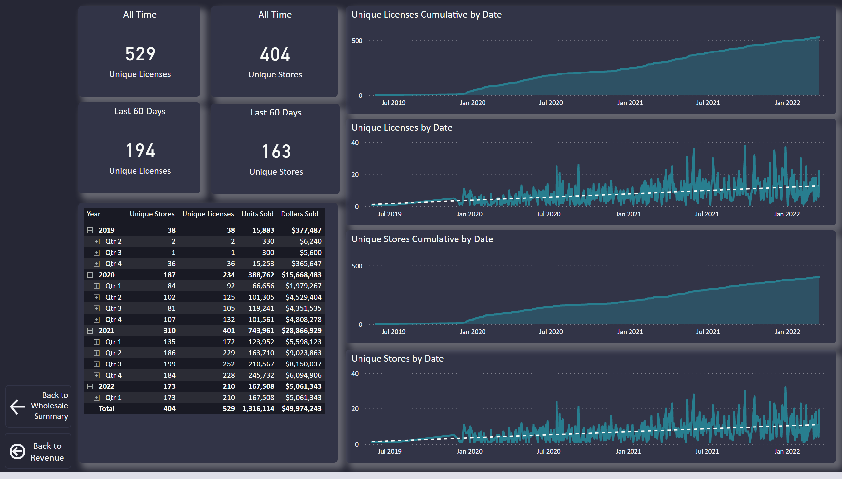
Account Analysis
Notes:
areaChart
No alt text provided
All Time
No alt text provided
lineChart
No alt text provided
All Time
No alt text provided
lineChart
No alt text provided
Last 60 Days
No alt text provided
Last 60 Days
No alt text provided
areaChart
No alt text provided
actionButton
No alt text provided
actionButton
No alt text provided
pivotTable
No alt text provided

Slide 26
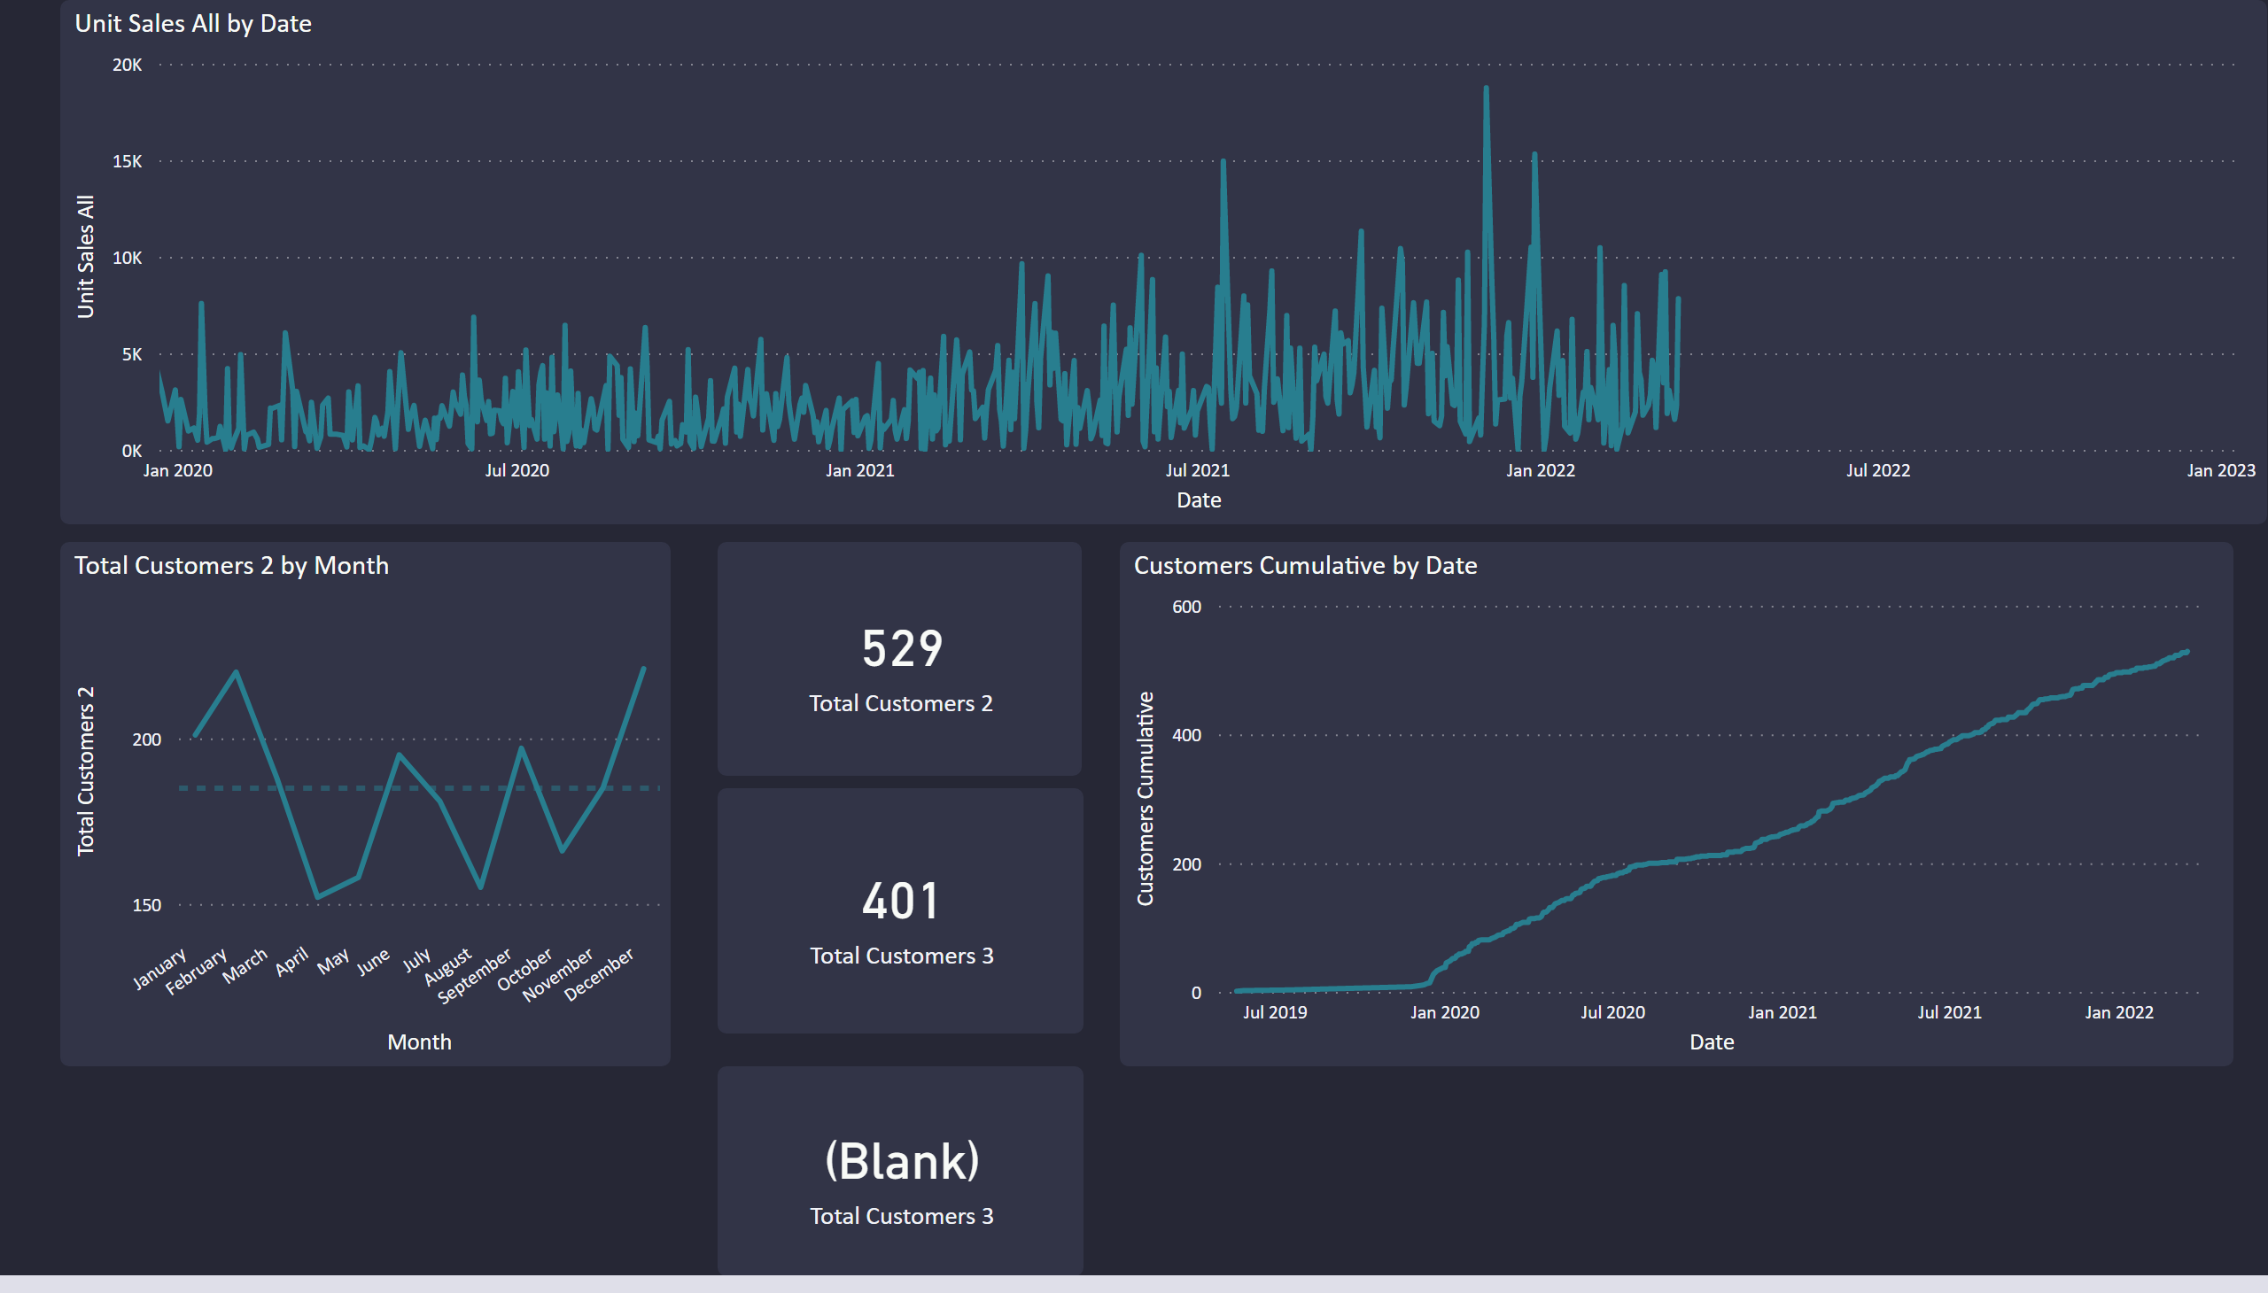
Page 1
Notes:
lineChart
No alt text provided
lineChart
No alt text provided
card
No alt text provided
card
No alt text provided
card
No alt text provided
lineChart
No alt text provided

Slide 27
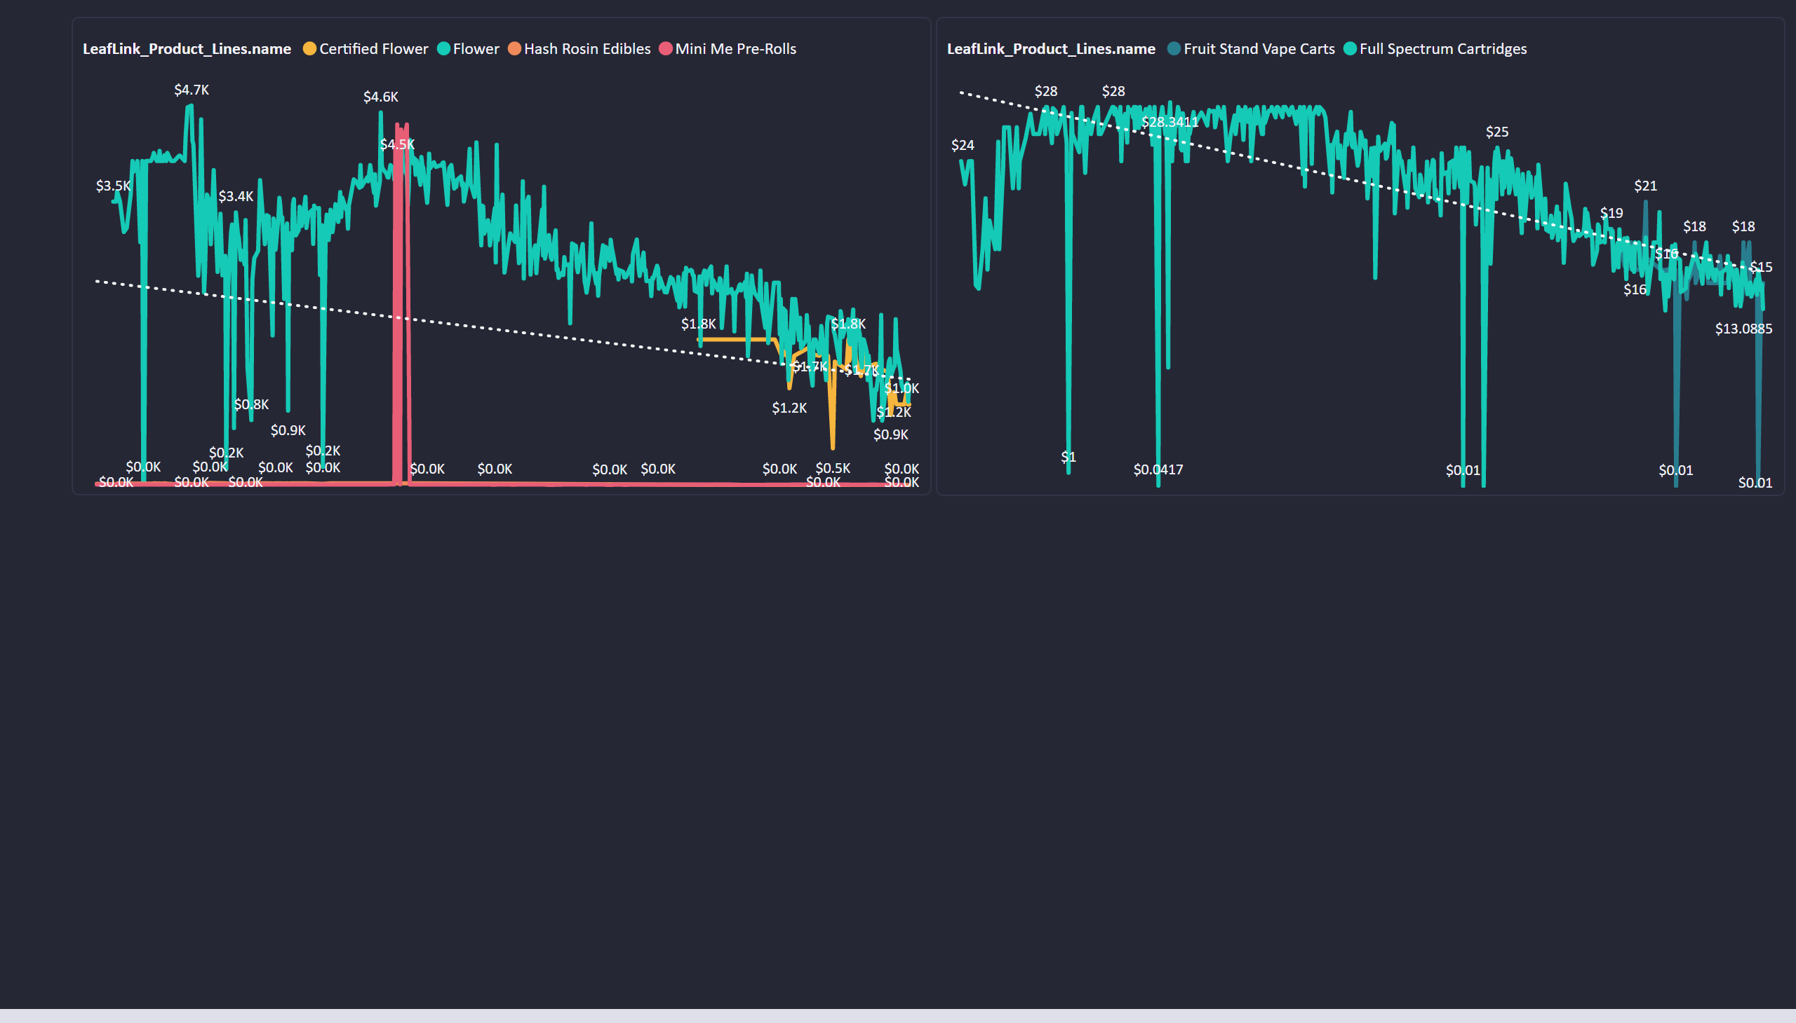
Page 2
Notes:
lineChart
No alt text provided
lineChart
No alt text provided

